Slide 1
GIS应用开发
Developing GIS Applications with ArcObjects using C#.NET
江西省研究生优质课程
主讲：兰小机 GIS博士、教授
Email : landcom8835@163.com
QQ ：305333315
      课件： ftp://218.87.136.94/

Slide 2
Chap.10 空间数据编辑 (8学时)
ArcGIS Engine 编辑概述
版本化空间数据编辑
DisplayFeedback对象
多边形挖空处理
分割线要素
线、面要素整形(Reshape)
要素合并
多部分要素的处理
线要素的延伸与修剪

Slide 3
10.1 ArcGIS Engine 编辑概述
  ArcGIS Engine 编辑与 ArcMap 编辑
  编辑流程
  Editing target layer
  Edit tasks
  Edit sketch
  Working with the operation stack
  Snap agents
  Edit events
  Feature inspectors

Slide 4
10.1.1 ArcGIS Engine 编辑与 ArcMap 编辑
ArcGIS桌面的编辑功能通过Editor库发布, ArcGIS Engine 的编辑功能包含在Controls 库中.
ArcGIS Engine Controls库中提供了内置的编辑命令、工具、菜单等，用于地理要素的复制、剪切、粘贴和删除、启动编辑、停止编辑、保存编辑、编辑工具（Edit Tool）、绘制工具（Sketch Tool）、编辑的目标图层ToolControl、属性编辑、要素编辑过程中右键菜单功能和Snapping设置等功能。 这些命令、工具等在开发过程中可以直接使用。

Slide 5
要素的复制、剪切、粘贴和删除
ControlToolsEditing_Copy | {2D7BD886-7531-4198-820D-551A5A14569E} esriControls.ControlsEditingCopyCommand
ControlToolsEditing_Cut | {C03E7512-CA4E-4197-8386-57830425D13A} esriControls.ControlsEditingCutCommand
ControlToolsEditing_Paste | {99FADFFD-A788-4F1F-A1B3-04909B06735A} esriControls.ControlsEditingPasteCommand
ControlToolsEditing_Clear | {C4CB4830-8C2E-49AE-9D12-73E822BCA90E} esriControls.ControlsEditingClearCommand

Slide 6
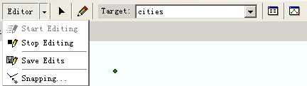
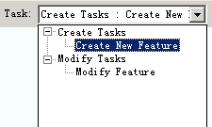
ArcGIS Engine环境下的EditorToolbar、Editor Menu and Edit Task:

Slide 7
ControlToolsEditing_Start | {5CAF45CD-E3B1-4FFD-96C4-BCDD2289C1EB} esriControls.ControlsEditingStartCommand
ControlToolsEditing_Stop | {8D03C271-BB00-4A36-9B84-AD2E1DE0DE11} esriControls.ControlsEditingStopCommand
ControlToolsEditing_Save | {0BB6A923-6AAF-4B7A-B8A8-A7225065A0C8} esriControls.ControlsEditingSaveCommand
ControlToolsEditing_Edit | {6F922BD8-EF26-4852-BAED-45CFF3A97121} esriControls.ControlsEditingEditTool
ControlToolsEditing_Sketch | {13B234E8-3B30-49CA-9967-4C76F7231AD6} esriControls.ControlsEditingSketchTool
ControlToolsEditing_TargetToolControl | {5D815B27-6A93-42DB-B2C6-1CC58B416E9F} esriControls.ControlsEditingTargetToolControl
ControlToolsEditing_Attribute | {A554ADBC-D0DD-469A-8A95-B4CEED0794C3} esriControls.ControlsEditingAttributeCommand
ControlToolsEditing_SketchProperties | {506ACF9B-B4B4-4A4A-A5FA-5215E4A240B2} esriControls.ControlsEditingSketchPropertiesCommand

Slide 8
撤销（undo） / 重复（redo）
ControlToolsGeneric_Redo | {B0675372-0271-4680-9A2C-269B3F0C01E8} esriControls.ControlsRedoCommand
ControlToolsGeneric_Undo | {380FB31E-6C24-4F5C-B1DF-47F33586B885} esriControls.ControlsUndoCommand

Slide 9
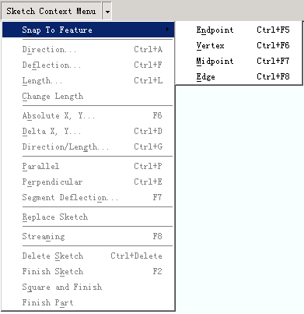
ArcGIS Engine的“Sketch Tool Context Menu”

Slide 10
ControlToolsEditing_SnapToFeatureMenu | {3E28536E-66EB-4812-BD8C-7AE6EA5CCB17} esriControls.ControlsEditingSnapToFeatureMenu
ControlToolsEditing_SnapEndpoint | {B473F50B-3D6B-4718-8DE3-75D7ECACED58} esriControls.ControlsEditingSnapEndpointCommand
ControlToolsEditing_SnapVertex | {78FF7F24-E5E6-4CA4-993E-6FAA81684441} esriControls.ControlsEditingSnapVertexCommand
ControlToolsEditing_SnapMidpoint | {250219D8-7A0B-4017-93EF-1E893D16F742} esriControls.ControlsEditingSnapMidpointCommand
ControlToolsEditing_SnapEdge | {5D67D843-E10C-4D0B-A69C-2DFA82B25450} esriControls.ControlsEditingSnapEdgeCommand

Slide 11
ControlToolsEditing_SketchDirection | {4E6E4BB5-4B2E-4E1F-8E08-18E24FF80A13} esriControls.ControlsEditingSketchDirectionCommand
ControlToolsEditing_SketchDeflection | {3ECE8CAB-3DAD-4B04-B586-D9B6369885C3} esriControls.ControlsEditingSketchDeflectionCommand
ControlToolsEditing_SketchLength | {FAF9D507-97DF-4F2E-835A-35A3DECF90B9} esriControls.ControlsEditingSketchLengthCommand
ControlToolsEditing_SketchChangeLength | {6EF1BE13-4FF4-4529-958D-46A418C99DD8} esriControls.ControlsEditingSketchChangeLengthCommand
ControlToolsEditing_SketchAbsoluteXY | {B368783B-9BDE-46A6-A712-2969C1F21FA2} esriControls.ControlsEditingSketchAbsoluteXYCommand
ControlToolsEditing_SketchDeltaXY | {061BD3E1-4245-4699-863C-DE478647FBE3} esriControls.ControlsEditingSketchDeltaXYCommand
ControlToolsEditing_SketchDirectionLength | {9DB473E5-BF90-465B-8758-74C656F136EB} esriControls.ControlsEditingSketchDirectionLengthCommand
ControlToolsEditing_SketchParallel | {798FED0C-978D-4DFA-A658-D3DADF9D414D} esriControls.ControlsEditingSketchParallelCommand
ControlToolsEditing_SketchPerpendicular | {A9F4EAD1-622C-4BC7-857B-55ABA51D5359} esriControls.ControlsEditingSketchPerpendicularCommand

Slide 12
ControlToolsEditing_SketchSegmentDeflection | {A1D97BFF-5B08-4852-8223-5714EC5811DB} esriControls.ControlsEditingSketchSegmentDeflectionCommand
ControlToolsEditing_SketchReplace | {C9DFFED3-57CC-485A-A5A1-CC510CE9DC97} esriControls.ControlsEditingSketchReplaceCommand
ControlToolsEditing_SketchStreaming | {4E8F7A0A-C3F3-462B-9632-D9981941A18E} esriControls.ControlsEditingSketchStreamingCommand
ControlToolsEditing_SketchDelete | {E5D330C9-8E98-4148-818F-7128D152DFD5} esriControls.ControlsEditingSketchDeleteCommand
ControlToolsEditing_SketchFinish | {2A876779-8A6A-4B73-9B89-AE0099B0571A} esriControls.ControlsEditingSketchFinishCommand
ControlToolsEditing_SketchFinishSquare | {73883500-776E-4E99-92B2-6ED6332558DD} esriControls.ControlsEditingSketchFinishSquareCommand
ControlToolsEditing_SketchFinishPart | {D69E981F-4FDE-4077-B224-0C58A35AF668} esriControls.ControlsEditingSketchFinishPartCommand
ControlToolsEditing_TaskToolControl | {BEB77C7B-4257-41DC-9447-C3C5C4C8F7C7} esriControls.ControlsEditingTaskToolControl

Slide 13
在ArcGIS 桌面环境中的主要编辑对象是Editor ，而在ArcGIS Engine 开发中则是EngineEditor (单实例对象) ;在相应的应用程序中，它们负责管理 edit sketch, current task, current target layer, edit workspace, edit selection, edit session properties, and snap environment.
EngineEditor 主要接口：IEngineEditor、IEngineEditLayers、IEngineEditProperties、IEngineEditProperties2、IEngineEditSketch、IEngineSnapEnvironment、 IEngineEditEvents 、IExtension (System)

Slide 14
Interfaces
IEditAnnotationProperties
IEditAttributeProperties
IEditLayers
IEditor3
IEditorZ
IEditProperties
IEditProperties2
IEditProperties3
IEditProperties4
IEditSketch3
IEditTaskSearch
IExtension (esriSystem)
IExtensionAccelerators (esriSystem)
IExtensionManager (esriSystem)
ISnapEnvironment3
ArcMap Editor主要接口：

Slide 15
the main editing interfaces
 | ArcGIS Engine | ArcGIS Desktop
Editing environment | IEngineEditor （New in 9.3） | IEditor
Edit tasks | IEngineEditTask （New in 9.3） | IEditTask
Edit sketch | IEngineEditSketch （New in 9.3） | IEditSketch
Edit layers | IEngineEditLayers （New in 9.3） | IEditLayers
Edit properties | IEngineEditProperties | IEditProperties
Edit events | IEngineEditEvents （New in 9.3） | IEditEvents

Slide 16
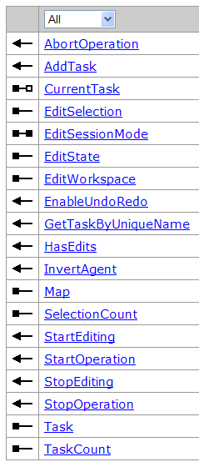
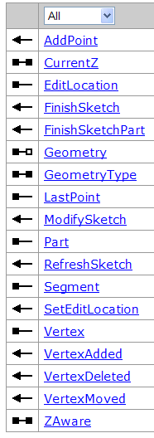
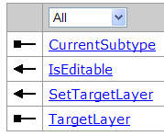
IEngineEditor
IEngineEditSketch
IEngineEditLayers

Slide 17
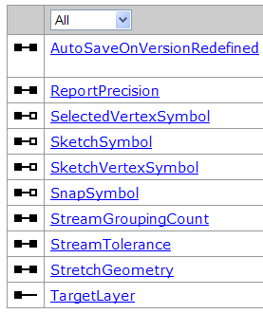
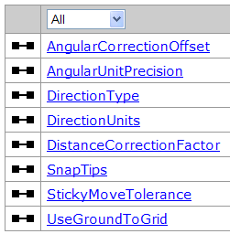
IEngineEditProperties
IEngineEditProperties2

Slide 18
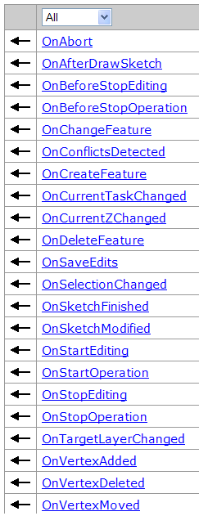
IEngineEditEvents （New in 9.3）

Slide 19
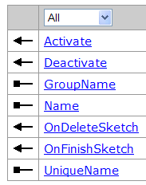
IEngineEditTask （ new at ArcGIS 9.3 ）
编辑任务使用编辑绘制几何对象(from IEngineEditSketch::Geometry )完成某项操作； EngineEditor 一次只能有一个活动的编辑任务，使用 IEngineEditor::CurrentTask 设置当前的编辑任务.
所有的 Engine 编辑任务都实现了IEngineEditTask 接口. Engine 编辑任务必须注册到‘ESRI Engine Edit Tasks’组件类目中，以便显示在 ControlsEditingTaskToolControl中 .

Slide 20
10.1.2 编辑流程
编辑会话（Edit session ）
  建议所有的编辑操作应该一个编辑会话中完成，当应用程序使用插入游标或更新游标进行批导入或批更新要素除外。
    编辑会话用于实现封装多个编辑和绘制操作的长事务处理。
    一个编辑会话中的数据变化只有执行该编辑会话的应用程序可见，编辑会话保存之前，其它并发的应用程序是看不到这些编辑变化的。

Slide 21
An edit session can be created using IEngineEditor (Controls) or IWorkspaceEdit (Geodatabase). 具体使用场合：
  Use IWorkspaceEdit to programmatically perform edits in console applications or graphical user interface (GUI)-based applications that don't require any user interaction.
  Use IEngineEditor for GUI-based editing applications that involve any of the following:
    Using the out-of-the-box editing commands
    Working with the edit sketch
    Controlling the snapping environment
    Listening to events that are raised while editing

Slide 22
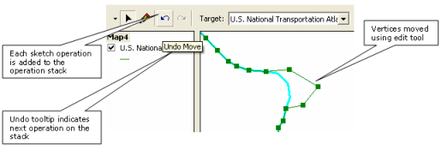
Edit and sketch operations
编辑操作用于创建、修改或删除要素，而绘制操作用于修改编辑绘制 （edit sketch）.
  编辑与绘制操作可以看作是嵌套在编辑会话对应的长事务中的一系列短事务。
通过把每个操作加入操作栈，实现编辑会话中的 undo /redo 功能。一旦编辑会话完成，所有操作都从操作栈删除。

Slide 23
Within the lifetime of the edit session, any sketch operations added to the operation stack are temporary. When the sketch is finished, sketch operations are removed and replaced with a single edit operation. When the edit session is finished, the operation stack is cleared.

Slide 24
Start an edit session
An edit session is started by calling the IEngineEditor.StartEditing method with two arguments— IMap and IWorkspace.
  Every editable layer from the same workspace that is present in the map can be edited in the edit session. The IEngineEditLayers.IsEditable property indicates whether a particular layer is editable. When working with SDE workspaces, set IEngineEditor.EditSessionMode to specify whether versioned or non-versioned layers are editable, as it is not possible to edit both types in a single edit session.
IEngineEditor

Slide 25
  private IEngineEditor m_engineEditor = new EngineEditorClass();
  private void StartEditing (IMap map, IFeatureLayer featureLayer)
  { if (m_engineEditor.EditState != esriEngineEditState.esriEngineStateNotEditing) return;
  IDataset dataset = featureLayer.FeatureClass as IDataset;
  IWorkspace workspace = dataset.Workspace;
  m_engineEditor.StartEditing(workspace, map); ((IEngineEditLayers) m_engineEditor). SetTargetLayer(featureLayer, -1);
  }
public void SetTargetLayer ( IFeatureLayer Layer, int SubType );

Slide 26
Edit operations
Perform all edits made in an edit session within an edit operation.
IEngineEditor.StartOperation --启动编辑操作
  public void StartOperation ( );
IEngineEditor.AbortOperation --取消编辑操作，不保存编辑
  public void AbortOperation ( );
IEngineEditor.StopOperation --结束编辑操作
  public void StopOperation ( string operationName );
  Calling StopOperation creates an edit operation that is added to the top of the operation stack.

Slide 27
private void cmdEditOperation()
  { m_engineEditor.StartOperation();
  try
  { //Perform feature edits here.
  if (someEditValidationChecksMethod == true)
  m_engineEditor.StopOperation(“Test edit operation”);
  else m_engineEditor.AbortOperation();
  }
  catch (Exception ex)
  { m_engineEditor.AbortOperation();
  //Add code to handle exception.
  }
  }

Slide 28
Save and stop an edit session
  Edits made during the edit session can be saved by executing ControlsEditingSaveCommand. Alternatively, call IEngineEditor.StopEditing with the saveChanges argument set to true.
    public void StopEditing ( bool saveChanges );
    若saveChanges为false，则不保存编辑变化结束编辑会话。

Slide 29
private void btnStopEditing_Click(object sender, EventArgs e)
  { if (m_engineEditor.HasEdits() == false)
  m_engineEditor.StopEditing(false);
  else
  { if (MessageBox.Show("Save Edits?", "Save Prompt", MessageBoxButtons.YesNo) == DialogResult.Yes)
  m_engineEditor.StopEditing(true);
  else m_engineEditor.StopEditing(false);
  }
  }

Slide 30
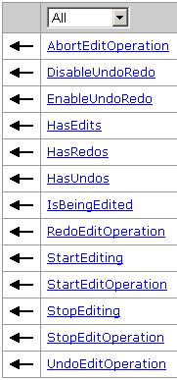
IWorkspaceEdit接口
IWorkspaceEdit接口是ArcObjects实现空间数据编辑功能的另一接口.
  它可以启动或停止一个编辑流程，适用于不需要用户交互的编辑操作。
使用StartEditing方法启动一个编辑流程
  public void StartEditing (bool withUndoRedo );
  withUndoRedo参数用来确定是否支持“undo /redo ”功能。

Slide 31
在启动编辑后，可以使用StartEditOperation方法开启编辑操作。
  public void StartEditOperation ( );
如果在编辑过程中出现了异常，可以使用AbortEditoperation方法来取消编辑操作。public void AbortEditOperation ( );
在完成一个编辑后，用户可以使用StopEditoperation方法来确保编辑操作的完成。
  public void StopEditOperation ( );
UndoEditoperation方法可以用于编辑状态的回滚操作，如果发现编辑过程有误，通过执行这个方法可以恢复到最近变化前的状态。
在整个编辑流程完成后，可以使用StopEditing方法来完成编辑。当执行完这个方法后，就意味着不能再进行“恢复／取消恢复”了。
  public void StopEditing ( bool saveEdits );

Slide 32
private void StartEditing (IFeatureLayer featureLayer)
  { IFeatureClass featureClass = featureLayer.FeatureClass;
  IDataset dataset = featureClass as IDataset;
  IWorkspaceEdit workspaceEdit = dataset.Workspace as IWorkspaceEdit;
  workspaceEdit.StartEditing(true);
  workspaceEdit.StartEditOperation();
  IFeature pFeature = featureClass.GetFeature(1);
  pFeature.Delete();
  workspaceEdit.StopEditOperation();
  bool bHasEdits = true;

Slide 33
  DialogResult iResponse = MessageBox.Show("Edit Operation", "Undo operation?", MessageBoxButtons.YesNo);
  if (iResponse == DialogResult.Yes) workspaceEdit.UndoEditOperation();
  workspaceEdit.HasEdits(ref bHasEdits);
  if (bHasEdits)
  { iResponse = MessageBox.Show("Edit Operation", "Save edits?", MessageBoxButtons.YesNo);
  if (iResponse == DialogResult.Yes)
  { workspaceEdit.StopEditing(true); }
  else
  { workspaceEdit.StopEditing(false); }
  } }

Slide 34
10.1.3 Editing target layer
IEngineEditLayers
使用IEngineEditLayers.SetTargetLayer 或ControlsEditingTargetToolControl设置要编辑的目标图层 。
使用IEngineEditLayers.TargetLayer 获得目前编辑的图层。
使用IEngineEditEvents.OnTargetLayerChanged 事件来监听编辑目标图层的变化。

Slide 35
10.1.4 Edit tasks
编辑任务需要使用edit sketch中的几何对象，执行某一特定的编辑操作。
Two out-of-the-box edit tasks are provided: Create New Feature and Modify Feature.
可以通过实现IEngineEditTask 接口创建定制的编辑任务

Slide 36
  IEngineEditTask.GroupName 属性允许编辑任务在ControlsEditingTaskToolControl 中逻辑分组.
  使用IEngineEditEvents.OnCurrentTaskChanged 事件监听编辑任务的改变。
  Use the ArcGIS Add Class Wizard to quickly create a class that implements IEngineEditTask. Choose Engine and Editor as the customization group, then choose Engine Edit Task as the base component.

Slide 37
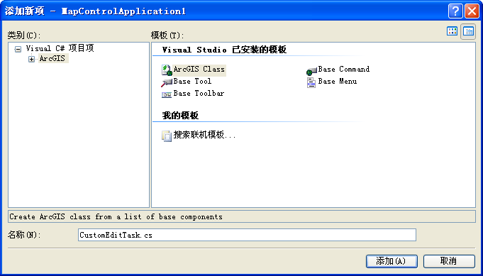
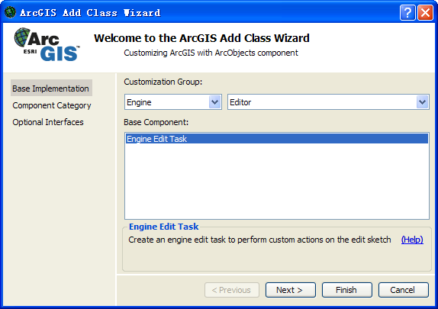
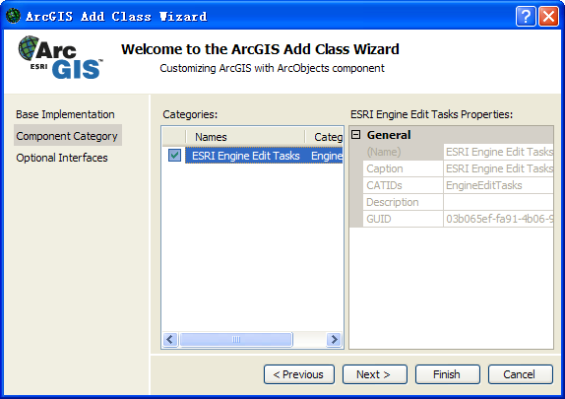
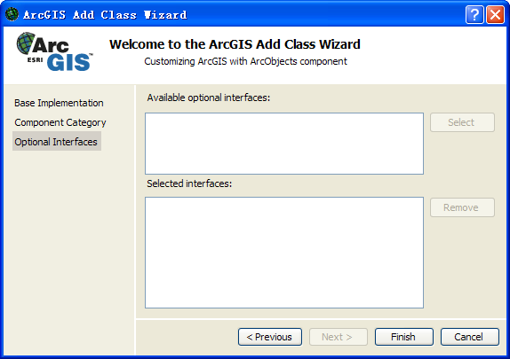


Slide 38
Typically, edit tasks are registered in the ESRI Engine Edit Tasks component category, although they can be added programmatically using the IEngineEditor.AddTask method.
Set or return the current edit task using the IEngineEditor.CurrentTask property. Alternatively, provide ControlsEditingTaskToolControl to allow the user to select the current edit task.

Slide 39
10.1.5 Edit sketch
IEngineEditSketch
IEngineEditSketch 中的geometry 用于完成当前的编辑任务，如当前编辑任务为“Create New Feature”时，使用该geometry来创建一个要素； geometry 由当前编辑任务设置，其类型可以是： a multipoint, a polyline, or a polygon , 与目标编辑图层的几何类型相同。

Slide 40
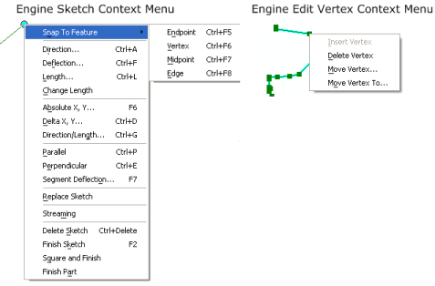
AE提供了2个快捷菜单帮助完成edit sketch geometry.
  ControlsEditingSketchContextMenu
  ControlsEditingVertexContextMenu

Slide 41
Creating a sketch operation
IEngineSketchOperation.Start 启动一绘制操作（sketch operation），使用IEngineSketchOperation.SetMenuString 方法命名该操作，以便操作栈（ operation stack ）能够识别该操作，并用作Undo / Redo 的ToolTip .
IEngineSketchOperation.Finish结束一绘制操作，并将该操作放入操作栈中。

Slide 42
  public void Start (IEngineEditor editor );
  public void SetMenuString (string MenuString );
  public void Finish ( IEnvelope invalEnv, esriEngineSketchOperationType opType, object Data );
    Finishes the sketch operation and puts it into the operation stack.
Constant | Value
esriEngineSketchOperationGeneral | 0
esriEngineSketchOperationVertexAdded | 1
esriEngineSketchOperationVertexDeleted | 2
esriEngineSketchOperationVertexMoved | 3

Slide 43
private void EngineSketchOperation()
  { IEngineSketchOperation sketchOp = new EngineSketchOperationClass();
  IEngineEditor engineEditor = new EngineEditorClass();
  IEngineEditSketch editSketch = (IEngineEditSketch) engineEditor;
  IEnvelope invalidateEnv = ((IClone) editSketch.Geometry.Envelope).Clone() as IEnvelope;
  sketchOp.Start(engineEditor);
  sketchOp.SetMenuString("Delete Vertex");
  IPointCollection pointCol = (IPointCollection) editSketch.Geometry;
  IClone vertexToRemove = (IClone) pointCol.get_Point(pointCol.PointCount - 1);
  vertexToRemove.Clone(); pointCol.RemovePoints(pointCol.PointCount - 1, 1);
  editSketch.Geometry = (IGeometry)pointCol; editSketch.RefreshSketch();
  sketchOp.Finish(invalidateEnv, esriEngineSketchOperationType.esriEngineSketchOperationVertexDeleted, vertexToRemove as System.Object);
  }

Slide 44
Undo or redo sketch operations
  To undo or redo an individual sketch operation, use the IEngineSketchOperation.Undo (derived from IOperationStack.Undo) or IEngineSketchOperation.Redo (derived from IOperationStack.Redo) methods.
  To undo or redo multiple sketch operations, access the operation stack using IToolbarControl2.OperationStack, then call the IOperationStack.Undo or IOperationStack.Redo methods respectively.
Sketch operation events
  IEngineEditEvents.OnVertexAdded
  IEngineEditEvents.OnVertexDeleted
  IEngineEditEvents.OnVertexMoved
  IEngineEditEvents.OnSketchModified

Slide 45
10.1.6 Working with the operation stack
由EngineEditor 管理的编辑会话，如果需要undo / redo功能，那么应用程序中必须包含ToolbarControl.
IToolbarControl.OperationStack 属性提供了对操作栈的访问.
The IOperationStack.Undo and IOperationStack.Redo methods can then be used to sequentially undo and redo operations respectively.

Slide 46
Adding edit and sketch operations to the operation stack
  在应用程序中添加ToolbarControl ，并设置其伙伴控件；
  实例化ControlsOperationStack ，并将其与ToolbarControl相关联；
  连接EngineEditor 到ToolbarControl ，使得操作栈包含编辑与绘制操作；Do this by adding a command from the Feature Editing toolset to the ToolbarControl or by programmatically linking the EngineEditor to the ToolbarControl in the Form_Load event.
  Start an edit session and enable undo and redo capabilities by setting IEngineEditor.EnableUndoRedo to true.

Slide 47
2:
  IOperationStack operationStack = new ControlsOperationStackClass();
  axToolbarControl1.OperationStack = operationStack;
  axToolbarControl2.OperationStack = operationStack;
3:
  object tbr = (object)axToolbarControl1.Object;
  IExtension engineEditorExt = m_engineEditor as IExtension;
  engineEditorExt.Startup(ref tbr);

Slide 48
Using the operation stack
  Edit operations are added to the operation stack when IEngineEditor.StopOperation is called, and sketch operations are added when IEngineSketchOperation.Finish is called.
  The Undo and Redo methods do not remove operations from the operation stack, but rather move an internal pointer up and down the stack.
  Individual operations can be accessed using IOperationStack.Item and performed using IOperationStack.Do, IOperationStack.UndoOperation, or IOperationStack.RedoOperation; however, this is not recommended for edit and sketch operations.

Slide 49
  IOperationStack operationStack = m_ToolbarControl.OperationStack;
  //Do the following to undo the previous operation on the stack.
  operationStack.Undo();
  //Do the following to redo the next operation on the stack.
  operationStack.Redo();

Slide 50
10.1.7 Working with the snap environment
捕捉设置：设置某个图层中的要素是否能够被捕捉以及设置捕捉的位置和在多大范围内可以捕捉到理想的位置。捕捉有助于精确定位要素及编辑绘制的顶点。
ArcGIS提供了两种类型捕捉环境：
  ArcGIS snapping environment (New in ArcGIS 10)：为捕捉提供了最通用框架，对ArcGIS桌面和ArcGIS Engine都可用，并使用相同的组件。
  Editing snapping environment：提供了更精细的捕捉，但只在编辑会话中可用，且对ArcGIS桌面和ArcGIS Engine使用不同的组件和接口(ISnapEnvironment for Desktop and IEngineSnapEnvironment for Engine)。

Slide 51
两种捕捉环境的比较
 | ArcGIS snapping environment | Editing snapping environment
Desktop support | Yes | Yes
Engine support | Yes | Yes
Configuration of snapping agents | Yes | Yes
Available outside an edit session | Yes | No
Requires management of cache | No | Yes
Respects definition queries on layers | Yes | No
Supports customization of snap tips | Yes | No
Supports filtering of individual layers | Yes | Yes
Supports custom snapping types | No | Yes
Access to snap result via the application programming interface (API) | Yes | No

Slide 52
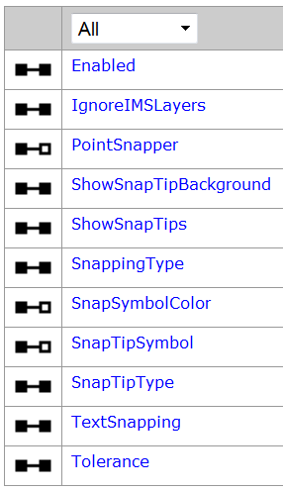
ArcGIS snapping environment
ISnappingEnvironment
ArcGIS 捕捉环境可用于所有的自定义工具，而不仅仅限于编辑器中的工具。在ArcMap 和ArcGIS Engine中， ArcGIS 捕捉环境是作为应用程序扩展来访问的。
ISnappingEnvironment 是ArcGIS 捕捉环境的主要接口，这个接口 用于控制捕捉是否激活、使用哪些类型的捕捉及设置捕捉容差、定义捕捉符号。 ArcGIS 捕捉环境还提供了IPointSnapper、ISnappingResult 和ISnappingFeedback 接口。

Slide 53
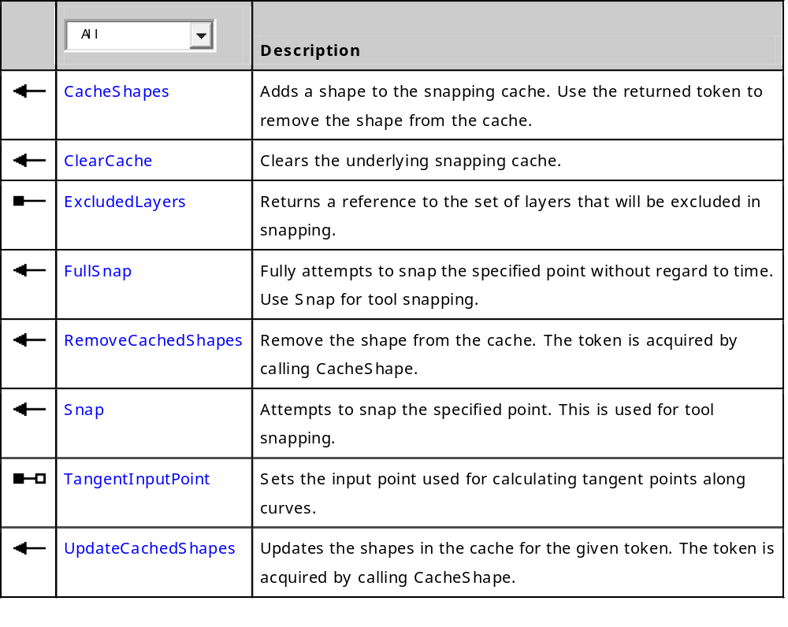
IPointSnapper

Slide 54
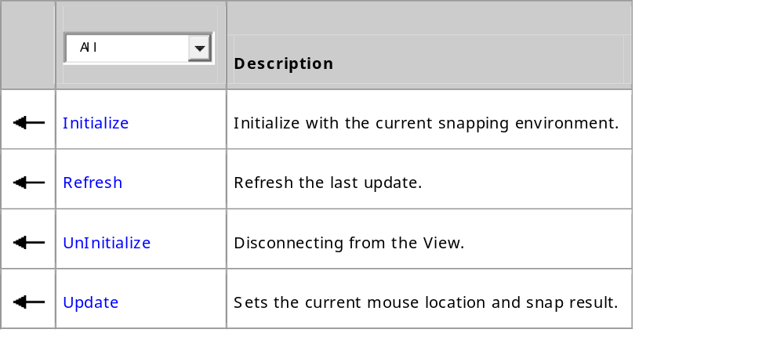
  ISnappingFeedback

Slide 55
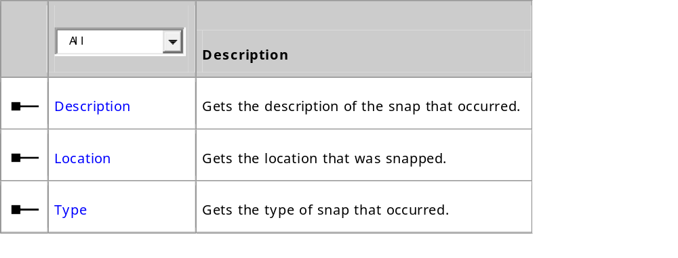
  ISnappingResult

Slide 56
Accessing the snapping environment from ArcMap
  ISnappingEnvironment m_SnappingEnv = m_application.FindExtensionByName("ESRI Snapping") as ISnappingEnvironment;
  IPointSnapper m_Snapper = m_SnappingEnv.PointSnapper;
  ISnappingFeedback m_SnappingFeedback = new SnappingFeedbackClass();
  m_SnappingFeedback.Initialize(hook, m_SnappingEnv, true);

Slide 57
Accessing the snapping environment from ArcGIS Engine
  IExtensionManager extensionManager = m_hookHelper2.ExtensionManager;
  if (extensionManager == null) return;
  UID guid = new UIDClass();
  guid.Value = "{E07B4C52-C894-4558-B8D4-D4050018D1DA}"; //Snapping extension.
  IExtension extension = extensionManager.FindExtension(guid);
  ISnappingEnvironment m_SnappingEnvironment = extension as ISnappingEnvironment;

Slide 58
esriSnappingType
Constant | Value | Description
esriSnappingTypeNone | 0 | No snap.
esriSnappingTypePoint | 1 | Snap to point.
esriSnappingTypeEndpoint | 2 | Snap to endpoint.
esriSnappingTypeVertex | 4 | Snap to vertex.
esriSnappingTypeEdge | 8 | Snap to edge.
esriSnappingTypeMidpoint | 16 | Snap to midpoint.
esriSnappingTypeIntersection | 32 | Intersection snapping.
esriSnappingTypeTangent | 64 | Tangent snapping.

Slide 59
Configuring the snapping environment
  //Specify combination of esriSnappingType enumerations.
  m_SnappingEnvironment.SnappingType = (esriSnappingType) ((int)esriSnappingType.esriSnappingTypeEdge + (int)esriSnappingType.esriSnappingTypeEndpoint);
  //Specify bitwise combination for edge and endpoint snapping.
  m_SnappingEnvironment.SnappingType = (esriSnappingType)63;

Slide 60
Snapping priority
  Snapping types are evaluated in a fixed order, as follows.
    esriSnappingTypePoint
    esriSnappingTypeIntersection
    esriSnappingTypeEndpoint
    esriSnappingTypeVertex
    esriSnappingTypeMidpoint
    esriSnappingTypeTangent
    esriSnappingTypeEdge
  SnappingType is an application-level setting.

Slide 61
Adding snapping to a custom tool
  If your custom tool calls the editor Sketch tool for input, you do not need to enable snapping in your tool because it is already built-in to the Sketch tool. For all other cases where your tool creates its own geometry, such as a point picker or other screen feedback, you can enable snapping.

Slide 62
To use ArcGIS snapping in your tools, follow these steps:
  In the tool's OnClick event,
    Obtain a reference to the snapping extension
    Acquire references to ISnappingEnvironment and IPointSnapper
    Initialize the SnappingFeedback (optional)
  In the tool's OnMouseMove event,
    Call IPointSnapper.Snap during mouse move using the current location
    If a SnapResult is returned:
      Update the cursor location
      Update the snapping feedback (if using feedback)
  In the tool's Refresh method,
    Refresh the snapping feedback (if using feedback)
  In most cases, the code to access the snapping environment should be included in the tool's OnClick method.

Slide 63
  public override void OnMouseMove(int Button, int Shift, int X, int Y)
  { //Convert the point from pixels to map units.
  m_CurrentMouseCoords = QueryMapPoint(m_screenDisplay, X, Y);
  //Test the location against the snap environment.
  ISnappingResult snapResult = m_Snapper.Snap(m_CurrentMouseCoords);
  //Update the snapping feedback.
  m_SnappingFeedback.Update(snapResult, 0);
  //Update the current location to move the cursor to the snapped location.
  if (snapResult != null)
  m_CurrentMouseCoords = snapResult.Location;
  m_linefeedback.MoveTo(m_CurrentMouseCoords);
  }

Slide 64
public override void Refresh( int hDC)
  {
  //Refresh the previous location of the snap tip.
  if (m_SnappingFeedback != null)
  m_SnappingFeedback.Refresh(hDC);
  }

Slide 65
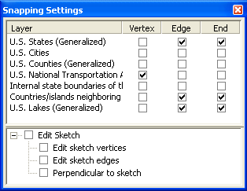
Editing snapping environment in ArcGIS Engine
可以使用ControlsEditingSnappingCommand 或IEngineSnapEnvironment 接口来访问捕捉设置.
通过实现IEngineSnapAgent 接口来创建定制的捕捉设置。

Slide 66
ArcGIS Engine的编辑捕捉环境 (IEngineSnapEnvironment) 控制每一个捕捉代理IEngineSnapAgent, 捕捉类型(hit type)设置, 及捕捉容差.
  每个捕捉代理的捕捉类型由IEngineFeatureSnapAgent 管理.
  All settings can be manually modified or verified on the Snapping Settings dialog box.

Slide 67
public void SnapEnvirSettings (IEngineEditor editor)
  { IEngineSnapEnvironment snapEnvironment = editor as IEngineSnapEnvironment;
  if (snapEnvironment.SnapAgentCount == 0)
  { System.Windows.Forms.MessageBox.Show(
  "You need to turn on at least one snapping agent!!!");
  return; }
  double tolerance = snapEnvironment.SnapTolerance; MessageBox.Show(Convert.ToString(tolerance));
  snapEnvironment.SnapToleranceUnits = esriEngineSnapToleranceUnits.esriEngineSnapToleranceMapUnits;
  snapEnvironment.SnapTolerance = 15;
  ((IEngineEditProperties2)editor).SnapTips = true;
  }

Slide 68
private void EditSnap (IMapControl3 mMap)
  { IEngineEditor m_engineEditor = new EngineEditorClass();
  if (m_engineEditor.EditState == esriEngineEditState.esriEngineStateNotEditing)
  { ILayer currentLayer = mMap.get_Layer(0);
  if (currentLayer is IFeatureLayer)
  { IFeatureLayer featureLayer = currentLayer as IFeatureLayer;
  IDataset dataset = featureLayer.FeatureClass as IDataset;
  IWorkspace workspace = dataset.Workspace;
  m_engineEditor.StartEditing (workspace, mMap.Map); ((IEngineEditLayers)m_engineEditor).SetTargetLayer( featureLayer, 0); }

Slide 69
  if (mMap.LayerCount != 0)
  { IEngineEditLayers editLayers = editor as IEngineEditLayers;
  IEngineSnapEnvironment snapEnvironment = editor as IEngineSnapEnvironment;
  IEngineFeatureSnapAgent featureSnapAgent = new EngineFeatureSnap();
  featureSnapAgent.FeatureClass = ((IFeatureLayer)mMap.get_Layer(0)).FeatureClass; ;
  featureSnapAgent.HitType = esriGeometryHitPartType.esriGeometryPartVertex | esriGeometryHitPartType.esriGeometryPartBoundary | esriGeometryHitPartType.esriGeometryPartEndpoint;
  snapEnvironment.AddSnapAgent(featureSnapAgent);
  } } }

Slide 70
Editing snapping environment in ArcMap
  ISnapEnvironment3
  ISnapAgent
  IFeatureSnapAgent2
  ISnapAgentFeedback

Slide 71
10.1.8 Edit events
Use the IEngineEditEvents interface to trap specific events that occur in an edit session.
  For example, custom validation code could be executed when a user completes the edit sketch by listening to the IEngineEditEvents.OnSketchFinished event.

Slide 72
Event order (Sample: EditingEditEventListener)
一个编辑操作可以触发IEngineEditEvents中的多个事件. 如：
  当IEngineEditor.StartEditing()或执行 ControlsEditingStartCommand时
    触发OnTargetLayerChanged , OnStartEditing, OnSelectionChanged, and OnSketchModified 事件.
  当通过IEngineEditor.CurrentTask 或ControlsEditingTaskToolControl改变当前任务时
    触发OnSketchModified, and OnCurrentTaskChanged 事件
  当IEngineEditor.StopEditing()或执行ControlsEditingStopCommand 时，
    触发OnTargetLayerChanged and OnStopEditing事件.

Slide 73
  private IEngineEditor m_EngineEditor = new EngineEditorClass();
  private IEngineEditEvents_Event m_EngineEditEvents;
  ……
  m_EngineEditEvents.OnStartEditing += new IEngineEditEvents_OnStartEditingEventHandler(OnStartEditingMethod);
  ……
  private void OnStartEditingMethod()
    {
    ……
    }

Slide 74
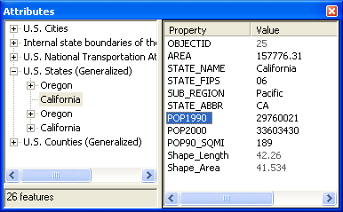
10.1.9 Feature inspectors
The ControlsEditingAttributeCommand dialog box contains two panels as shown in the following screen shot.
It is also possible to replace the default feature inspector with a custom feature inspector by implementing the IEngineObjectInspector interface and registering the class as a feature class extension.
  Custom feature inspectors can only be assigned to feature classes in a geodatabase.

Slide 75
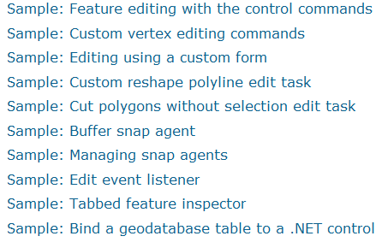
Samples:

Slide 76
10.1.10 Using feature templates
ArcGIS 10 编辑环境中提供了创建要素的要素模板。要素模板提供了快速创建要素的途径，因为设置编辑环境的属性及要素的属性都已预定义好了。
要素模板与要素图层(FeatureLayer)相关联，且作为图层的扩展存储在图层中。

Slide 77
Creating feature templates
启动编辑会话时，如果要素图层尚未有要素模板，ArcMap编辑器会为每个要素图层自动创建要素模板。
使用IEditTemplate 、IEditTemplateFactory接口创建要素模板，并通过IEditor3 管理要素模板。 IEditor3.CurrentTemplate返回当前模板(IEditTemplate) .

Slide 78
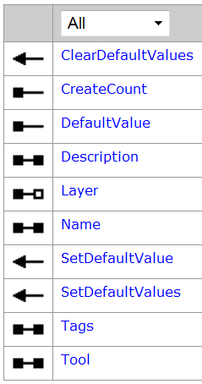
IEditTemplate
IEditTemplateFactory仅定义了Create方法，用来创建编辑模板。
  public IEditTemplate Create ( string Name, ILayer Layer);
Use IEditor3.AddTemplates to add the template to the editor.

Slide 79
private void CreateFeatureTemplate( IMxDocument m_doc, IEditor3 m_editor)
  { //Create a single template for the selected layer.
  ILayer editLayer = m_doc.SelectedLayer;
  IEditTemplateFactory editTemplateFact = new EditTemplateFactoryClass();
  IEditTemplate newEditTemplate = editTemplateFact.Create("Building", editLayer);
  //Add the template.
  IArray templateArray = new ArrayClass();
  templateArray.Add(newEditTemplate);
  m_editor.AddTemplates(templateArray);
  }

Slide 80
Accessing feature templates
public void GetEditTemplateManager( ILayer layer)
  { ILayerExtensions layerExtensions = layer as ILayerExtensions;
  IEditTemplateManager editTemplateMgr;
  for (int j = 0; j < layerExtensions.ExtensionCount; j++)
  { object extension = layerExtensions.get_Extension(j);
  if (extension is IEditTemplateManager)
  { editTemplateMgr = extension as IEditTemplateManager;
  IEditTemplate editTemplate = editTemplateMgr.get_EditTemplate(0);
  editTemplate.SetDefaultValue("Name", "Venice", true);
  } }
  }

Slide 81
public void m_editEvents_OnSketchFinished( IEditor3 m_editor)
  { IEditSketch3 m_edSketch = m_editor as IEditSketch3;
  m_editor.StartOperation();
  IPoint point = m_edSketch.LastPoint;
  IEditTemplate editTemplate = m_editor.CurrentTemplate;
  IFeatureLayer featLayer = editTemplate.Layer as IFeatureLayer;
  IFeatureClass featClass = featLayer.FeatureClass;
  IFeature newFeature = featClass.CreateFeature();
  newFeature.Shape = point;
  editTemplate.SetDefaultValues(newFeature);
  newFeature.Store();
  m_editor.StopOperation("Create Point");
  m_editor.Display.Invalidate(newFeature.Extent, true, (short)esriScreenCache.esriAllScreenCaches);
  }

Slide 82
Removing templates
IEditor3.RemoveTemplate
  public void RemoveTemplate ( IEditTemplate editTemplate);
IEditor3.RemoveAllTemplatesInMap
  public void RemoveAllTemplatesInMap ( IMap map);
IEditor3.RemoveAllTemplatesInLayer
  public void RemoveAllTemplatesInLayer ( ILayer layer);

Slide 83
10.2 版本化空间数据编辑
版本化编辑的相关接口
Obtaining changes made in the current edit session
Finding differences between versions
Reconciling versions
Listening to versioned events

Slide 84
版本化编辑的相关接口
版本管理(基本)
  IVersion
  IVersion2
版本化编辑
  IVersionEdit
  IVersionEdit2
  IVersionEdit3, IVersionEdit4
版本管理(高级)
  IVersionedWorkspace
  IVersionedWorkspace2
  IVersionedWorkspace3
事件接口：
  IVersionEvents_Event
  IVersionEvents2_Event

Slide 85
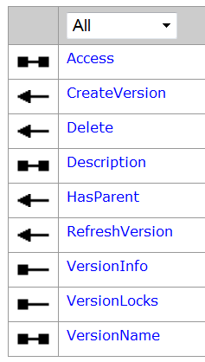
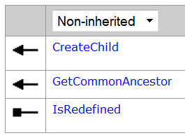
IVersion
IVersion2
IVersion2 inherits from IVersion, the IVersion interface has been superseded by IVersion2.

Slide 86
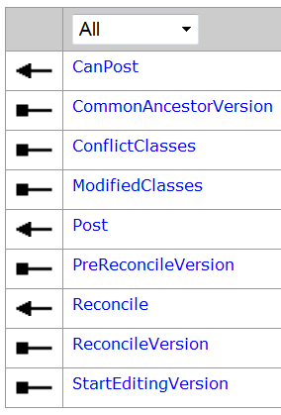
Note: the IVersionEdit interface has been superseded by IVersionEdit4.
IVersionEdit
  public bool Reconcile ( string VersionName);
IVersionEdit2增加：
  public bool Reconcile2 ( string VersionName, bool acquireLock );
IVersionEdit2增加：
  public bool Reconcile3 ( string VersionName, bool acquireLock, bool abortIfConflicts);
IVersionEdit4增加：
  public bool Reconcile4 ( string VersionName, bool acquireLock, bool abortIfConflicts, bool ChildWins, bool ColumnLevel);
IVersionEdit

Slide 87
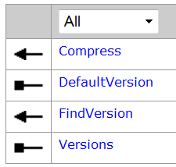
Note: the IVersionedWorkspace interface has been superseded by IVersionedWorkspace3.
IVersionedWorkspace
IVersionedWorkspace2增加：
  public IEnumVersionInfo RecommendedReconcileOrder {get;}
IVersionedWorkspace3增加：
  public IEnumBSTR RecommendedSyncOrder {get;}
  An ordered list of replicas that need to be synchronized.

Slide 88
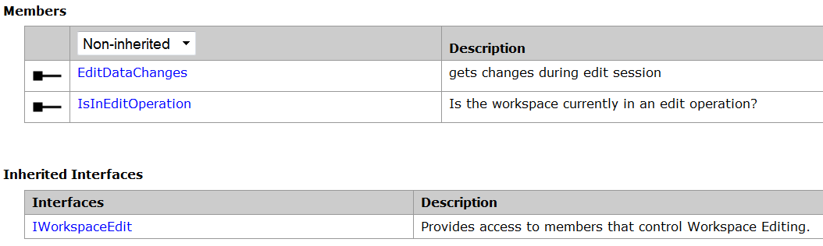
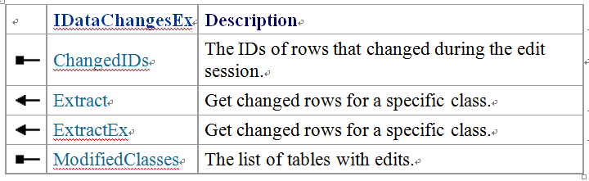
Obtaining changes made in the current edit session
esriEditDataChangesType Constant | Value | Description
esriEditDataChangesWithinSession | 0 | Changes since the start of the edit session.
esriEditDataChangesWithinOperation | 1 | Changes since the start of the edit operation
IWorkspaceEdit2
  public IDataChangesEx get_EditDataChanges ( esriEditDataChangesType editChangeType);
  public bool IsInEditOperation {get;}

Slide 89
esriDifferenceType Constant | Value | Description
esriDifferenceTypeInsert | 0 | Row was inserted in this version.
esriDifferenceTypeDeleteNoChange | 1 | Row has been deleted in this version and not changed in the difference version.
esriDifferenceTypeUpdateNoChange | 2 | Row has been updated in this version and not changed in the difference version.
esriDifferenceTypeUpdateUpdate | 3 | Row has been updated in both versions.
esriDifferenceTypeUpdateDelete | 4 | Row has been updated in this version but deleted in the difference version.
esriDifferenceTypeDeleteUpdate | 5 | Row has been deleted in this version but updated in the difference version.

Slide 90
public IEnumBSTR GetModifiedClasses (IWorkspace workspace)
  {
  IWorkspaceEdit2 workspaceEdit2 = (IWorkspaceEdit2) workspace;
  IDataChangesEx dataChanges = workspaceEdit2.get_EditDataChanges
  (esriEditDataChangesType.esriEditDataChangesWithinSession);
  return dataChanges.ModifiedClasses;
  }

Slide 91
public IFIDSet InsertedAndDeletedIDs (IDataChangesEx dataChangesEx, String className)
  { // Get the IDs of inserted rows.
  IFIDSet insertFidSet = dataChangesEx.get_ChangedIDs (className, esriDifferenceType.esriDifferenceTypeInsert);
  // Get the IDs of deleted rows.
  IFIDSet deleteNoChangeFidSet = dataChangesEx.get_ChangedIDs(className, esriDifferenceType.esriDifferenceTypeDeleteNoChange);
  // Join the two ID sets and return the result.
  IFIDSetOperator fidSetOperator = (IFIDSetOperator) insertFidSet;
  return fidSetOperator.Union(deleteNoChangeFidSet);
  }

Slide 92
public void DisplayModifiedValues (IDataChangesEx dataChangesEx, String className)
  { // Get a cursor over the updated rows.
  IDifferenceCursorEx differenceCursorEx = dataChangesEx.ExtractEx (className, esriDifferenceType.esriDifferenceTypeUpdateNoChange);
  // Prepare the output parameters.
  int featureID = -1; IRow sourceRow = null;
  IRow differenceRow = null; ILongArray fieldIndexes = null;
  // Iterate through the cursor.
  differenceCursorEx.Next(out featureID, out sourceRow, out differenceRow, out fieldIndexes);
  while (featureID != -1)
  { Console.WriteLine("Changes for feature {0}:", featureID);
  // Go to each changed field and display the old and new values.
  for (int i = 0; i < fieldIndexes.Count; i++)
  { Console.WriteLine("Previous value: {0}", sourceRow.get_Value(i));
  Console.WriteLine(“Current value: {0}”, differenceRow.get_Value(i)); }
  differenceCursorEx.Next(out featureID, out sourceRow, out differenceRow, out fieldIndexes);
  }
  }

Slide 93
Finding differences between versions
Establishing references to the versions
  public IFIDSet FindVersionDifferences (IWorkspace workspace, String childVersionName, String parentVersionName, String tableName, esriDifferenceType differenceType)
  { // Get references to the child and parent versions.
  IVersionedWorkspace versionedWorkspace = (IVersionedWorkspace) workspace;
  IVersion childVersion = versionedWorkspace.FindVersion("ChildVersion");
  IVersion parentVersion = versionedWorkspace.FindVersion("ParentVersion");

Slide 94
Detecting the differences
  // Cast to the IVersion2 interface to find the common ancestor.
  IVersion2 childVersion2 = (IVersion2)childVersion;
  IVersion commonAncestorVersion = childVersion2.GetCommonAncestor(parentVersion);
  // Cast the child version to IFeatureWorkspace and open the table.
  IFeatureWorkspace childFWS = (IFeatureWorkspace)childVersion;
  ITable childTable = childFWS.OpenTable(tableName);
  // Cast the common ancestor version to IFeatureWorkspace and open the table.
  IFeatureWorkspace commonAncestorFWS = (IFeatureWorkspace)commonAncestorVersion;
  ITable commonAncestorTable = commonAncestorFWS.OpenTable(tableName);

Slide 95
  // Cast to the IVersionedTable interface to create a difference cursor.
  IVersionedTable versionedTable = (IVersionedTable) childTable;
  IDifferenceCursor differenceCursor = versionedTable.Differences
  (commonAncestorTable, differenceType, null);
  // Create output variables for the IDifferenceCursor.Next method and a FID set.
  IFIDSet fidSet = new FIDSetClass();
  IRow differenceRow = null;
  int objectID = -1;
  // Step through the cursor, showing the ID of each modified row.
  differenceCursor.Next(out objectID, out differenceRow);
  while (objectID != -1)
  { fidSet.Add(objectID);
  differenceCursor.Next(out objectID, out differenceRow); }
  fidSet.Reset(); return fidSet;
  }

Slide 96
Obtaining differences between historical versions
  public IFIDSet FindHistoricalDifferences (IWorkspace workspace, String historicalMarkerName, String tableName, esriDifferenceType differenceType)
  { // Cast to the IHistoricalWorkspace interface and get the 2004 and default versions.
  IHistoricalWorkspace historicalWorkspace = (IHistoricalWorkspace) workspace;
  IHistoricalVersion defaultVersion = historicalWorkspace.FindHistoricalVersionByName(historicalWorkspace.DefaultMarkerName);
  IHistoricalVersion historicalVersion = historicalWorkspace.FindHistoricalVersionByName(historicalMarkerName);
  // Cast both versions to IFeatureWorkspace and open the table from each.
  IFeatureWorkspace defaultFWS = (IFeatureWorkspace)defaultVersion;
  IFeatureWorkspace historicalFWS = (IFeatureWorkspace)historicalVersion;
  ITable defaultTable = defaultFWS.OpenTable(tableName);
  ITable historicalTable = historicalFWS.OpenTable(tableName);

Slide 97
  // Create a difference cursor.
  IVersionedTable versionedTable = (IVersionedTable)defaultTable;
  IDifferenceCursor differenceCursor = versionedTable.Differences(historicalTable, differenceType, null);
  // Create output variables for the IDifferenceCursor.Next method and a FID set.
  IFIDSet fidSet = new FIDSetClass();
  IRow differenceRow = null;
  int objectID = -1;
  // Step through the cursor, showing the ID of each modified row.
  differenceCursor.Next(out objectID, out differenceRow);
  while (objectID != -1)
  { fidSet.Add(objectID);
  differenceCursor.Next(out objectID, out differenceRow); }
  fidSet.Reset();
  return fidSet;
  }

Slide 98
Reconciling versions
public bool IVersionEdit4.Reconcile4 ( string VersionName, bool acquireLock, bool abortIfConflicts, bool ChildWins, bool ColumnLevel);

Slide 99
  public void ReconcileandPost (IVersion editVersion, IVersion targetVersion)
  { IMultiuserWorkspaceEdit muWorkspaceEdit = (IMultiuserWorkspaceEdit) editVersion;
  IWorkspaceEdit workspaceEdit = (IWorkspaceEdit) editVersion;
  IVersionEdit4 versionEdit = (IVersionEdit4) editVersion;
  if (muWorkspaceEdit.SupportsMultiuserEditSessionMode(esriMultiuserEditSessionMode.esriMESMVersioned))
  { muWorkspaceEdit.StartMultiuserEditing(esriMultiuserEditSessionMode.esriMESMVersioned);
  //Reconcile with the target version.
  bool conflicts = versionEdit.Reconcile4(targetVersion.VersionName, true, false, false, false);

Slide 100
  if (conflicts)
  MessageBox.Show(" Conflicts Detected ");
  Else
  MessageBox.Show(" No Conflicts Detected ");
  workspaceEdit.StartEditOperation();
  //Post to the target version.
  if (versionEdit.CanPost()) versionEdit.Post(targetVersion.VersionName);
  workspaceEdit.StopEditOperation();
  workspaceEdit.StopEditing(true);
  }
  }

Slide 101
Listening to versioned events
IVersionEvents_Event publishes the following events:
  OnConflictsDetected
  OnReconcile
  OnRedefineVersion
  OnRefreshVersion
IVersionEvents2_Event publishes the following additional events:
  OnArchiveUpdated
  OnBeginReconcile
  OnDeleteVersion
  OnPost
IVersionEvents2_Event does not extend IVersionEvents_Event.

Slide 102
public void SetVersionEvent (IVersion version)
  { // Cast the version to the event interface.
  IVersionEvents_Event versionEvent = (IVersionEvents_Event) version;
  // Instantiate the delegate type and add it to the event.
  versionEvent.OnReconcile += new IVersionEvents_OnReconcileEventHandler(OnReconcile);
  }
public void OnReconcile (String targetVersionName, Boolean hasConflicts)
  {
  // TODO: Implement the event handling.
  }

Slide 103
10.3 DisplayFeedback对象
DisplayFeedback是让用户能够使用鼠标与控件进行可视化交互的对象集，主要用于创建、修改几何对象。

Slide 104
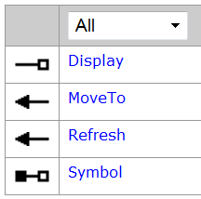
所有的DisplayFeedback类都实现了IDisplayFeedback接口，这个接口定义了它们的公共方法和属性，如Display、Symbol属性和MoveTo、Refresh方法。
一般地，当DisplayFeedback对象初始化的时候，程序员需要给它们设置Display和Symbol属性，然后才让它们开始MoveTo。如果不明确设置一个Symbol属性，系统将会给DisplayFeedback一个缺省的Symbol对象。

Slide 105
10.3.1 产生新Geometry的Feedback对象
NewLineFeedback、NewPolygonFeedback、NewBezierCurveFeedback
绘制圆形和Envelope对象

Slide 106
(1 ) NewLineFeedback、NewPolygonFeedback、NewBezierCurveFeedback
NewLineFeedback，NewPolygonFeedback，NewBezierCurveFeedback三个对象用来返回各自的新几何对象，如Polyline、Polygon和BezierCurve(贝塞尔曲线)。这三个Feedback对象在产生几何形体时需要的鼠标事件都是MouseDown、MouseMove和MouseDblClick。
三个对象尽管产生的几何形体对象不一样，但是它们使用的方法都是大同小异的，如在MouseDown事件中使用Start方法添加一个起始点或者使用AddPoint添加点；在MouseMove事件中使用MoveTo方法来移动鼠标到一个新的点；在MouseDblClick事件中Stop方法将返回产生的几何形体对象。

Slide 107
Create Polyline By Feedback
public sealed class CreatePolylineTool : BaseTool
  { IHookHelper m_hookHelper = null; IMap m_Map;
  IActiveView m_ActiveView; INewLineFeedback pLineFeedback;
  IFeatureLayer m_pCurrentLayer; IPoint m_pPoint;
  public CreatePolylineTool( IFeatureLayer featureLayer)
  { base.m_category = "高级编辑"; base.m_caption = "创建线要素";
  base.m_message = "创建线要素"; base.m_toolTip = "创建线要素";
  base.m_name = "CreatePolylineTool";
  string bitmapResourceName = GetType().Name + ".bmp";
  base.m_bitmap = new Bitmap(GetType(), bitmapResourceName);
  base.m_cursor = new System.Windows.Forms.Cursor(GetType(), GetType().Name + ".cur");
  m_pCurrentLayer = featureLayer;
  }

Slide 108
public override void OnCreate(object hook)
  {
  m_hookHelper = new HookHelperClass();
  m_hookHelper.Hook = hook;
  m_ActiveView = m_hookHelper.ActiveView;
  m_Map = m_hookHelper.FocusMap;
  }

Slide 109
public override void OnMouseDown(int Button, int Shift, int X, int Y)
  { //获得鼠标在控件上点击的位置，产生一个点对象
  IPoint pPt = m_ActiveView.ScreenDisplay.DisplayTransformation.ToMapPoint(X, Y);
  if (pLineFeedback == null)
  { pLineFeedback = new NewLineFeedbackClass();
  pLineFeedback.Display = m_ActiveView.ScreenDisplay;
  pLineFeedback.Start(pPt); }
  else
  { pLineFeedback.AddPoint(pPt); }
  }

Slide 110
public override void OnMouseMove(int Button, int Shift, int X, int Y)
  {
  IPoint pPt = m_ActiveView.ScreenDisplay.DisplayTransformation.ToMapPoint(X, Y);
  //MoveTo方法继承自IDisplayFeedback接口的定义
  if (pLineFeedback != null) pLineFeedback.MoveTo(pPt);
  m_pPoint = m_ActiveView.ScreenDisplay.DisplayTransformation.ToMapPoint(X, Y);
  }

Slide 111
public override void OnDblClick()
  { IGeometry pGeom = null; IPointCollection pPointCollection = null;
  pLineFeedback.AddPoint(m_pPoint);
  IPolyline pPolyLine = pLineFeedback.Stop();
  if (pPolyLine != null)
  pPointCollection = (IPointCollection)pPolyLine;
  if (pPointCollection.PointCount < 2)
  MessageBox.Show("You must have at least two vertices in a line.", "Bad Line Geometry", MessageBoxButtons.OK, MessageBoxIcon.Exclamation);
  else
  pGeom = (IGeometry)pPointCollection;
  pLineFeedback = null;
  CreateFeature(pGeom);
  }

Slide 112
private void CreateFeature( IGeometry pGeom)
  { if (pGeom == null || m_pCurrentLayer == null) return;
  IWorkspaceEdit pWorkspaceEdit = GetWorkspaceEdit();
  IFeatureLayer pFeatureLayer = (IFeatureLayer)m_pCurrentLayer;
  IFeatureClass pFeatureClass = pFeatureLayer.FeatureClass;
  pWorkspaceEdit.StartEditOperation();
  IFeature pFeature = pFeatureClass.CreateFeature();
  try { pFeature.Shape = pGeom; }
  catch (Exception ex)
  { MessageBox.Show("创建要素", ex.Message); }
  pFeature.Store();
  pWorkspaceEdit.StopEditOperation(); m_ActiveView.PartialRefresh(esriViewDrawPhase.esriViewGeography, m_pCurrentLayer, pGeom.Envelope);
  }

Slide 113
private IWorkspaceEdit GetWorkspaceEdit()
  { if (m_pCurrentLayer == null) return null;
  IFeatureLayer pFeatureLayer = (IFeatureLayer)m_pCurrentLayer;
  IFeatureClass pFeatureClass = pFeatureLayer.FeatureClass;
  IDataset pDataset = (IDataset)pFeatureClass;
  if (pDataset == null) return null;
  return (IWorkspaceEdit)pDataset.Workspace;
  }

Slide 114
(2) 绘制圆形和Envelope对象
NewEnvelopeFeedback和NewCircleFeedback两个对象返回的也是几何图形，但是它们的事件却是另外的三种类型：MouseDown，MouseMove，MouseUp。因为这矩形和圆形的绘制不需要双击鼠标来显示图形绘制完成。
当绘制一个圆形对象的时候，用户首先选择一个点作为圆心，然后移动鼠标，在释放鼠标的点处确定了圆的半径，这样一个圆就绘制完成了。

Slide 115
Create Circle by Feedback
public sealed class CreateCircleTool : BaseTool
  {
  IHookHelper m_hookHelper = new HookHelperClass();
  IMap m_Map; IActiveView m_ActiveView;
  INewCircleFeedback pCircleFeedback;
  IFeatureLayer m_pCurrentLayer;
  public CreateCircleTool( IFeatureLayer featureLayer)
  { ……
  m_pCurrentLayer = featureLayer;
  }

Slide 116
public override void OnCreate(object hook)
  { m_hookHelper.Hook = hook;
  m_ActiveView = m_hookHelper.ActiveView;
  m_Map = m_hookHelper.FocusMap;
  }
  public override void OnMouseDown(int Button, int Shift, int X, int Y)
  { //获得鼠标在控件上点击的位置，产生一个点对象
  IPoint pPt = m_ActiveView.ScreenDisplay.DisplayTransformation.ToMapPoint(X, Y);
  if (pCircleFeedback == null)
  { pCircleFeedback = new NewCircleFeedbackClass();
  pCircleFeedback.Display = m_ActiveView.ScreenDisplay;
  pCircleFeedback.Start(pPt); }
  }

Slide 117
public override void OnMouseMove(int Button, int Shift, int X, int Y)
  {
  IPoint pPt = m_ActiveView.ScreenDisplay.DisplayTransformation.ToMapPoint(X, Y);
  //MoveTo方法继承自IDisplayFeedback接口的定义
  if (pCircleFeedback != null) pCircleFeedback.MoveTo(pPt);
  }
  public override void OnMouseUp(int Button, int Shift, int X, int Y)
  { IGeometry pGeo = null;
  pGeo = pCircleFeedback.Stop();
  pCircleFeedback = null;
  CreateFeature(pGeo);
  }

Slide 118
private void CreateFeature(IGeometry pGeom)
  { IWorkspaceEdit pWorkspaceEdit = GetWorkspaceEdit();
  IFeatureLayer pFeatureLayer = (IFeatureLayer)m_pCurrentLayer;
  IFeatureClass pFeatureClass = pFeatureLayer.FeatureClass;
  IConstructCircularArc pConstructArc = pGeom as IConstructCircularArc;
  IPolygon pPolygon = new PolygonClass();
  ISegmentCollection pSegmentCollection = pPolygon as ISegmentCollection;
  ISegment pSegment = pConstructArc as ISegment;
  object missing = Type.Missing;
  pSegmentCollection.AddSegment(pSegment, ref missing, ref missing);
  pWorkspaceEdit.StartEditOperation();
  IFeature pFeature = pFeatureClass.CreateFeature();
  pFeature.Shape = pPolygon;
  pFeature.Store();
  pWorkspaceEdit.StopEditOperation();
  m_ActiveView.PartialRefresh(esriViewDrawPhase.esriViewGeography, m_pCurrentLayer, pGeom.Envelope);
  }

Slide 119
10.3.2 移动几何对象上的节点
LineMovePointFeedback、BezierMovePointFeedback和PolygonMovePointFeedback三个对象移动节点的方法是一样的，且使用的鼠标事件也都是MouseDown、MouseMove和 MouseUp。
LineMovePointFeedback、BezierMovePointFeedback类都实现了ILineMovePointFeedback接口。

Slide 120
ILineMovePointFeedback和 IPolygonMovePointFeedback接口中定义的 Start方法
  public void Start ( IPolyline polyline, int pointIndex, IPoint Point );
  public void Start ( Ipolygonpolygon, int pointIndex, IPoint Point);
    要求传入三个参数，即需要移动节点的几何形体对象，移动的点索引号和鼠标点击位置。
    为了获得点索引号这个参数，需要使用IHitTest接口定义的方法来实现。
  实现了IHitTest接口的对象有 Envelope、Point、Multipoint、Polyline和 Polygon，这个接口只有一个方法 IHitTest::HitTest，通过这个方法可以得到查询点查询范围内的节点索引号。

Slide 121
public bool HitTest (
  IPoint QueryPoint,
  double searchRadius,
  esriGeometryHitPartType geometryPart,
  IPoint hitPoint,
  ref double hitDistance,
  ref int hitPartIndex,
  ref int hitSegmentIndex,
  ref bool bRightSide
  );

Slide 122
“移动要素顶点”开发实例(位于“空间数据编辑”菜单中)

Slide 123
10.3.3 移动整个对象
MovePointFeedback、MoveLineFeedback、MovePolygonFeedback和MoveEnvelopeFeedback把点、线、包络线（Envelope）或者多边形整体移动。它们移动整个几何形体对象而不改变几何形体对象的形状。
每一个这样的Feedback对象都有自己的接口，不过它们定义的方法都是相似的，Start方法用于开始移动，Stop方法用于停止移动。

Slide 124
10.3.4 其他DisplayFeedback
MoveGeometryFeedback
  如果打算同时移动多个几何对象，可以使用 MoveGeometryFeedback来实现。IMoveGeometryFeedback::AddGeometry方法用于添加要移动的对象；MoveGeometryFeedback::ClearGeometry可以清除DisplayFeedback中所有要移动的几何对象。Start方法用于设置移动的起始点。
ReshapeFeedback对象
  ReshapeFeedback对象可以用于对一个实现了 IPath 接口的对象进行整形的任务，实现IPath接口的对象包括Path和Ring。它可以对Polyline和Polygon整形。IReshapeFeedback::Start的Stretch参数则决定了变形的方式。

Slide 125
ResizeEnvelopeFeedback对象
  ResizeEnvelopeFeedback对象用于改变一个Envelope对象的尺寸外观，读者可以使用ResizeEdge属性来确定是移动Envelop的边或角。Constraints属性可以确定整形时的对象尺寸比例，如整形为一个正方行或者整形过程中Envelope的宽度和高度保持一定的比例。
StretchLineFeedback对象
  如果希望能够旋转或者伸缩一个已经存在的polyline对象，则可以使用 StretchLineFeedack来完成这个任务。
  IStretchLineFeedback接口定义了一个属性Anchor，它用于确定旋转过程中的固定点，这个点一般设置为Polyine的起始点或者终止点。如果没有设置，则系统默认使用起始点作为这个锚点，Anchor属性需要在 IStretchLineFeedback::Start方法使用后进行设置。

Slide 126
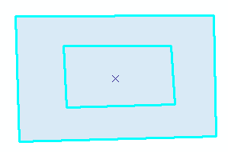

10.4 多边形挖空处理
问题背景
  在CAD中，四合院房屋的表达，不合语义。
  实现思路：在两多边形公共部分点击鼠标，选择两个多边形，然后对两个多边形进行差分运算。

Slide 127
public sealed class PolygonsDifference : BaseTool
  { IApplication m_application = null; IHookHelper m_hookHelper = null;
  IActiveView m_activeView = null; IMap m_map = null;
  IEngineEditProperties m_engineEditor = null;
  public PolygonsDifference()
  { base.m_category = "空间数据编辑";
  base.m_caption = "多边形挖空处理";
  base.m_message = "多边形挖空处理";
  base.m_toolTip = "多边形挖空处理";
  base.m_name = "PolygonsDifference";
  string bitmapResourceName = GetType().Name + ".bmp";
  base.m_bitmap = new Bitmap(GetType(), bitmapResourceName);
  base.m_cursor = new System.Windows.Forms.Cursor(GetType(), GetType().Name + ".cur");
  m_engineEditor = new EngineEditorClass();
  }

Slide 128
public override void OnCreate(object hook)
  { m_hookHelper = new HookHelperClass();
  m_hookHelper.Hook = hook;
  }
  public override void OnClick()
  { ILayer layer = m_engineEditor.TargetLayer;
  if (layer == null)
  { MessageBox.Show("请先启动编辑！！", "信息提示", MessageBoxButtons.OK, MessageBoxIcon.Information);
  return;
  }
  }

Slide 129
public override void OnMouseDown(int Button, int Shift, int X, int Y)
  { ILayer layer = m_engineEditor.TargetLayer;
  if (layer == null) { MessageBox.Show(……); return; }
  m_activeView = m_hookHelper.ActiveView;
  m_map = m_hookHelper.FocusMap;
  IPoint pPoint = m_activeView.ScreenDisplay.DisplayTransformation.ToMapPoint(X, Y);
  ISelectionEnvironment pSelectionEnvironment = new SelectionEnvironmentClass();
  pSelectionEnvironment.PointSelectionMethod = esriSpatialRelEnum.esriSpatialRelWithin;
  m_map.SelectByShape(pPoint as IGeometry, pSelectionEnvironment, false);
  if (m_map.SelectionCount != 2) { MessageBox.Show(……); return; }
  m_activeView.PartialRefresh(esriViewDrawPhase.esriViewGeoSelection, null, m_activeView.Extent);

Slide 130
  IEnumFeature pEnumFeature = m_map.FeatureSelection as IEnumFeature;
  IFeature firstFeature = pEnumFeature.Next();
  IFeature secondFeature = pEnumFeature.Next();
  bool firstPolygonIsLarge = false;
  IGeometry pGeometry = null;
  IRelationalOperator pRelOp1 = firstFeature.Shape as IRelationalOperator;
  IRelationalOperator pRelOp2 = secondFeature.Shape as IRelationalOperator;
  ITopologicalOperator pTopologicalOperator = null;
  if (pRelOp1.Contains(secondFeature.Shape))
  { pTopologicalOperator = firstFeature.Shape as ITopologicalOperator;
  pGeometry = pTopologicalOperator.Difference(secondFeature.Shape);
  firstPolygonIsLarge = true; }
  else if (pRelOp2.Contains(firstFeature.Shape))
  { pTopologicalOperator = secondFeature.Shape as ITopologicalOperator;
  pGeometry = pTopologicalOperator.Difference(firstFeature.Shape);
  firstPolygonIsLarge = false; }
  else return;

Slide 131
  bool deleteInteriorPolygon = false;
  DialogResult pDialogResult = MessageBox.Show("是否要删除内多边形？", "操作提示", MessageBoxButtons.YesNo);
  if (pDialogResult == DialogResult.Yes)
  { deleteInteriorPolygon = true; }
  IFeatureClass featureClass = firstFeature.Class as IFeatureClass;
  IDataset dataset = featureClass as IDataset;
  IWorkspaceEdit workspaceEdit = dataset.Workspace as IWorkspaceEdit;
  if (!(workspaceEdit.IsBeingEdited())) return;
  workspaceEdit.StartEditOperation();

Slide 132
  if (firstPolygonIsLarge)
  { firstFeature.Shape = pGeometry;
  firstFeature.Store();
  if (deleteInteriorPolygon) secondFeature.Delete();
  }
  else { secondFeature.Shape = pGeometry;
  secondFeature.Store();
  if (deleteInteriorPolygon) firstFeature.Delete();
  }
  workspaceEdit.StopEditOperation();
  m_map.ClearSelection();
  m_activeView.PartialRefresh(esriViewDrawPhase.esriViewGeography, null, m_activeView.Extent);
  }

Slide 133
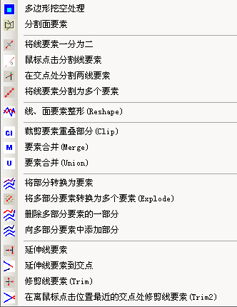
10.5 分割线要素

Slide 134
在交点处分割两线要素
实现思路：先选择第一要素、第二要素，然后移动鼠标到要分割的交点处（可能有多个交点）点击，即可将两线要素都在该交点处一分为二。

Slide 135
public sealed class Split2LinesAt1IntersectTool : BaseTool
  { IHookHelper m_hookHelper = null;
  IActiveView m_activeView = null;
  IMap m_map = null;
  IEngineEditProperties m_engineEditor = null;
  IPoint m_firstPoint = null;
  IPoint m_secondPoint = null;
  IPoint m_activePoint = null;
  IFeature m_firstFeature = null;
  IFeature m_secondFeature = null;
  enum ToolPhase { SelectFirstFeature, SelectSecondFeature,Split }
  ToolPhase m_toolPhase;
  IMultipoint intersectPoints = null;
  IPoint nearestIntersectPoint = null;

Slide 136
public Split2LinesAt1IntersectTool()
  { base.m_category = "空间数据编辑";
  base.m_caption = "在交点处分割线要素";
  base.m_message = "在交点处分割线要素";
  base.m_toolTip = "在交点处分割线要素";
  base.m_name = "Split2LinesAt1IntersectTool";
  base.m_bitmap = new Bitmap(GetType(), "SplitAt1Intersect.bmp");
  base.m_cursor = new System.Windows.Forms.Cursor(GetType(), GetType().Name + ".cur");
  m_engineEditor = new EngineEditorClass();
  }

Slide 137
public override void OnCreate(object hook)
  { m_hookHelper = new HookHelperClass();
  m_hookHelper.Hook = hook;
  if (m_hookHelper == null)
  base.m_enabled = false;
  else
  base.m_enabled = true;
  m_activeView = m_hookHelper.ActiveView;
  m_map = m_hookHelper.FocusMap;
  m_firstPoint = new PointClass();
  m_secondPoint = new PointClass();
  m_activePoint = new PointClass();
  }

Slide 138
public override void OnClick()
  { m_toolPhase = ToolPhase.SelectFirstFeature;
  ILayer layer = m_engineEditor.TargetLayer;
  if (layer == null)
  { MessageBox.Show("请先启动编辑！！", "信息提示", MessageBoxButtons.OK, MessageBoxIcon.Information);
  return; }
  }
  public override bool Deactivate()
  { m_firstFeature = null;
  m_secondFeature = null;
  m_firstPoint = null;
  m_secondPoint = null;
  m_activePoint = null;
  return true;
  }

Slide 139
public override void OnKeyDown (int keyCode, int Shift)
  {// If the Escape key is used, throw away the calculated point.
  if (keyCode == (int)Keys.Escape)
  {
  m_toolPhase = ToolPhase.SelectFirstFeature;
  m_map.ClearSelection(); m_activeView.PartialRefresh(esriViewDrawPhase.esriViewGeoSelection, null, m_activeView.Extent);
  }
  }

Slide 140
public override void OnMouseDown (int Button, int Shift, int X, int Y)
  { if (Button != (int)Keys.LButton) return;
  ILayer layer = m_engineEditor.TargetLayer;
  if (layer == null) { MessageBox.Show("请先启动编辑！！", "信息提示", MessageBoxButtons.OK, MessageBoxIcon.Information);
  return; }
  m_activePoint = m_activeView.ScreenDisplay.DisplayTransformation.ToMapPoint(X, Y);
  switch (m_toolPhase)
  { case (ToolPhase.SelectFirstFeature):
  GetFirstFeature(); break;
  case (ToolPhase.SelectSecondFeature):
  GetSecondFeafeature(); break;
  case (ToolPhase.Split):
  SplitFeafeatures(m_firstFeature, m_secondFeature); break;
  } }

Slide 141
public override void OnMouseMove (int Button, int Shift, int X, int Y)
  { if (m_toolPhase != ToolPhase.Split) return;
  IPoint point = m_activeView.ScreenDisplay.DisplayTransformation.ToMapPoint(X, Y);
  nearestIntersectPoint = FindNearestIntersectPoint(intersectPoints as IPointCollection, point);
  if (nearestIntersectPoint != null)
  { FlashGeometry(nearestIntersectPoint, 5, 10);
  m_activeView.PartialRefresh(esriViewDrawPhase.esriViewForeground, null, m_activeView.Extent);
  }
  }

Slide 142
private void GetFirstFeature()
  { m_firstPoint = m_activePoint;
  m_firstFeature = SelctFeatureBasedMousePoint(m_firstPoint);
  if (m_firstFeature != null) m_toolPhase = ToolPhase.SelectSecondFeature;
  }
  private void GetSecondFeafeature()
  { if (m_firstFeature == null)
  { m_toolPhase = ToolPhase.SelectFirstFeature; return; }
  m_secondPoint = m_activePoint;
  m_secondFeature = SelctFeatureBasedMousePoint(m_secondPoint);
  if (m_secondFeature == null)
  { m_toolPhase = ToolPhase.SelectSecondFeature; return; }
  intersectPoints = GetintersectPoints(m_secondFeature, m_firstFeature);
  if (intersectPoints == null)
  { m_toolPhase = ToolPhase.SelectSecondFeature; }
  else { m_toolPhase = ToolPhase.Split; }
  }

Slide 143
private IMultipoint GetintersectPoints( IFeature m_secondFeature, IFeature m_firstFeature)
  { IGeometry geometry1 = m_firstFeature.ShapeCopy;
  IGeometry geometry2 = m_secondFeature.ShapeCopy;
  ITopologicalOperator2 topo1 = geometry1 as ITopologicalOperator2;
  topo1.IsKnownSimple_2 = false;
  topo1.Simplify();
  ITopologicalOperator2 topo2 = geometry2 as ITopologicalOperator2;
  topo2.IsKnownSimple_2 = false;
  topo2.Simplify();
  IMultipoint intersectPoints = topo2.Intersect(geometry1, esriGeometryDimension.esriGeometry0Dimension) as IMultipoint;
  return intersectPoints;
  }

Slide 144
private void SplitFeafeatures( IFeature m_firstFeature, IFeature m_secondFeature)
  { if (intersectPoints == null) return;
  if (nearestIntersectPoint == null) return;
  SplitOneFeature(m_firstFeature);
  SplitOneFeature(m_secondFeature);
  m_map.ClearSelection(); m_activeView.PartialRefresh(esriViewDrawPhase.esriViewGeography | esriViewDrawPhase.esriViewGeoSelection, null, m_activeView.Extent);
  m_toolPhase = ToolPhase.SelectFirstFeature;
  }

Slide 145
private void SplitOneFeature( IFeature splitFeature )
  { IPolycurve curveToSplit = splitFeature.ShapeCopy as IPolycurve;
  double distanceOnCurve = 0;
  double nearestDistance = 0;
  bool isRightSide = false;
  IPoint outPoint = new PointClass();
  bool SplitHappened;
  int newPartIndex;
  int newSegmentIndex;
  ISegmentCollection polyline = null;
  IFeature newFeature = null;
  IFeatureClass splitFeatureClass = splitFeature.Class as IFeatureClass;
  IDataset dataset = splitFeatureClass as IDataset;
  IWorkspaceEdit workspaceEdit = dataset.Workspace as IWorkspaceEdit;
  if (!(workspaceEdit.IsBeingEdited())) return;

Slide 146
public void SplitAtPoint (
IPoint splitPoint,
bool projectOnto,
bool createPart,
ref bool SplitHappened,
ref int newPartIndex,
ref int newSegmentIndex);
Adds a new vertex along the curve as the specified input point, or the projection onto the curve of the specified input point.
  try { curveToSplit.QueryPointAndDistance(esriSegmentExtension.esriNoExtension, nearestIntersectPoint, false, outPoint, ref distanceOnCurve, ref nearestDistance, ref isRightSide);
  curveToSplit.SplitAtPoint(outPoint, true, true, out SplitHappened, out newPartIndex, out newSegmentIndex);
  IGeometryCollection geometryCollection = curveToSplit as IGeometryCollection;
  workspaceEdit.StartEditOperation();
  for (int i = 0; i < geometryCollection.GeometryCount; i++)
  { ISegmentCollection partGeom = geometryCollection.get_Geometry(i) as ISegmentCollection;
  object missing = Type.Missing;
  polyline = new PolylineClass();
  for (int k = 0; k < partGeom.SegmentCount; k++)
  { polyline.AddSegment(partGeom.get_Segment(k), ref missing, ref missing); }
public void QueryPointAndDistance (
esriSegmentExtension extension,
IPoint inPoint,
bool asRatio,
IPoint outPoint,
ref double DistanceAlongCurve,
ref double distanceFromCurve,
ref bool bRightSide);
Finds the point on the curve closest to inPoint, then copies that point to outPoint; optionally calculates related items.

Slide 147
  newFeature = splitFeatureClass.CreateFeature();
  for (int j = 0; j < splitFeature.Fields.FieldCount; j++)
  { if (splitFeature.Fields.get_Field(j).Editable)
  { newFeature.set_Value(j, splitFeature.get_Value(j)); }
  }
  FlashGeometry(polyline as IGeometry,3,50);
  newFeature.Shape = polyline as IGeometry;
  newFeature.Store();
  partGeom = null;
  }
  splitFeature.Delete();
  workspaceEdit.StopEditOperation();
  }
  catch (Exception ex) { workspaceEdit.AbortEditOperation();
  MessageBox.Show("分割线要素失败！！" + ex.Message, "信息提示", MessageBoxButtons.OK, MessageBoxIcon.Information); }
  }

Slide 148
private IPoint FindNearestIntersectPoint (IPointCollection intersectPoints, IPoint secondPoint)
  { IPoint point = null; double minDistance = 0.0;
  double distance = 0.0; int minDistancePointIdx = -1;
  for (int i = 0; i < intersectPoints.PointCount; i++)
  { point = intersectPoints.get_Point(i);
  distance = (point.X - secondPoint.X) * (point.X - secondPoint.X) + (point.Y - secondPoint.Y) * (point.Y - secondPoint.Y);
  if (i == 0) { minDistance = distance;
  minDistancePointIdx = 0; }
  else { if (distance < minDistance)
  { minDistance = distance;
  minDistancePointIdx = i; } }
  }
  if (minDistancePointIdx != -1)
  return intersectPoints.get_Point(minDistancePointIdx);
  else return null;
  }

Slide 149
10.6 线、面要素整形(Reshape)
实现思路：先选择要整形的线或面要素，然后绘制整形线即可。

Slide 150
public sealed class ReshapeTool : BaseTool
  { IHookHelper m_hookHelper = null;
  IActiveView m_activeView = null;
  IMap m_map = null;
  IEngineEditProperties m_engineEditor = null;
  IPoint m_activePoint = null;
  IFeature m_selectedFeature = null;
  enum ToolPhase { SelectFeature, DrawSketchAndReshape }
  ToolPhase m_toolPhase;

Slide 151
public ReshapeTool()
  { ……
  m_engineEditor = new EngineEditorClass();
  }
  public override void OnCreate(object hook)
  {
  m_hookHelper = new HookHelperClass();
  m_hookHelper.Hook = hook;
  m_activePoint = new PointClass();
  }

Slide 152
public override void OnClick()
  { m_toolPhase = ToolPhase.SelectFeature;
  ILayer layer = m_engineEditor.TargetLayer;
  if (layer == null)
  { MessageBox.Show("请先启动编辑！！", "信息提示", MessageBoxButtons.OK, MessageBoxIcon.Information);
  return; }
  }
  public override bool Deactivate()
  { m_selectedFeature = null; m_activePoint = null;
  return true; }
  public override void OnKeyDown(int keyCode, int Shift)
  { if (keyCode == (int)Keys.Escape)
  { m_toolPhase = ToolPhase.SelectFeature;
  m_map.ClearSelection();
  m_activeView.PartialRefresh(esriViewDrawPhase.esriViewGeoSelection, null, m_activeView.Extent); }
  }

Slide 153
public override void OnMouseDown(int Button, int Shift, int X, int Y)
  { m_activeView = m_hookHelper.ActiveView;
  m_map = m_hookHelper.FocusMap;
  if (m_map == null || m_activeView == null) return;
  m_activePoint = m_activeView.ScreenDisplay.DisplayTransformation.ToMapPoint(X, Y);
  switch (m_toolPhase)
  { case (ToolPhase.SelectFeature):
  base.m_cursor = new Cursor(GetType(), "arrow_l.cur");
  GetSelectedFeature();
  base.m_cursor = new Cursor(GetType(), "pen.cur");
  break;
  case (ToolPhase.DrawSketchAndReshape):
  base.m_cursor = new Cursor(GetType(), "pen.cur");
  DrawAndReshape();
  base.m_cursor = new Cursor(GetType(), "arrow_l.cur");
  break;
  }
  }

Slide 154
private void GetSelectedFeature()
  { if (m_activePoint == null) return;
  IPoint mousePoint = m_activePoint;
  m_selectedFeature = SelctFeatureBasedMousePoint(mousePoint);
  if (m_selectedFeature != null)
  m_toolPhase = ToolPhase.DrawSketchAndReshape;
  }

Slide 155
private void DrawAndReshape()
  { //在屏幕上绘制用于整形的线要素
  IScreenDisplay screenDisplay = m_activeView.ScreenDisplay;
  ISimpleLineSymbol sym = new SimpleLineSymbolClass();
  IRgbColor color = new RgbColorClass();
  color.Red = 255; color.Green = 0; color.Blue = 0;
  sym.Color = color;
  sym.Style = esriSimpleLineStyle.esriSLSSolid; sym.Width = 2;
  IRubberBand reshapeBand = new RubberLineClass();
  IGeometry reshapeGeom = reshapeBand.TrackNew(screenDisplay, sym as ISymbol);
  screenDisplay.StartDrawing(screenDisplay.hDC, (short)esriScreenCache.esriNoScreenCache);
  screenDisplay.SetSymbol(sym as ISymbol);
  screenDisplay.DrawPolyline(reshapeGeom);
  screenDisplay.FinishDrawing();

Slide 156
  IGeometry editShape = m_selectedFeature.ShapeCopy;
  IFeatureClass featureClass = m_selectedFeature.Class as IFeatureClass;
  IPointCollection reshapePath = new PathClass();
  reshapePath.AddPointCollection(reshapeGeom as IPointCollection);
  //reshape the selected feature
  if (featureClass.ShapeType == esriGeometryType.esriGeometryPolyline)
  { IPolyline polyline = editShape as IPolyline;
  polyline.Reshape(reshapePath as IPath); }
  if (featureClass.ShapeType == esriGeometryType.esriGeometryPolygon)
  { IGeometryCollection geometryCollection = editShape as IGeometryCollection;
  IRing ring = null;
  for (int i = 0; i < geometryCollection.GeometryCount; i++)
  { ring = geometryCollection.get_Geometry(i) as IRing;
  ring.Reshape(reshapePath as IPath); }
  }

Slide 157
  IDataset dataset = featureClass as IDataset;
  IWorkspaceEdit workspaceEdit = dataset.Workspace as IWorkspaceEdit;
  try { workspaceEdit.StartEditOperation();
  m_selectedFeature.Shape = editShape;
  m_selectedFeature.Store();
  workspaceEdit.StopEditOperation(); }
  catch (Exception ex)
  { workspaceEdit.AbortEditOperation();
  MessageBox.Show("要素整形失败！！" + ex.Message, "信息提示", MessageBoxButtons.OK, MessageBoxIcon.Information); } m_activeView.PartialRefresh(esriViewDrawPhase.esriViewGeography | esriViewDrawPhase.esriViewGeoSelection, null, m_activeView.Extent);
  m_toolPhase = ToolPhase.SelectFeature;
  }

Slide 158
private IFeature SelctFeatureBasedMousePoint(IPoint pPoint)
  { ITopologicalOperator pTopo = pPoint as ITopologicalOperator;
  IGeometry pBuffer = pTopo.Buffer(0.5);
  IGeometry pGeometry = pBuffer.Envelope;
  SetAllPolylinePolygonLayersSelectable();
  ISelectionEnvironment selEnvironment = new SelectionEnvironmentClass();
  selEnvironment.CombinationMethod = esriSelectionResultEnum.esriSelectionResultNew;
  m_map.SelectByShape(pGeometry, selEnvironment, true);
  IEnumFeature SelectedFeatures = m_map.FeatureSelection as IEnumFeature;
  SelectedFeatures.Reset();
  IFeature selFeature = SelectedFeatures.Next();
  SetAllLayersSelectable();
  m_activeView.PartialRefresh(esriViewDrawPhase.esriViewGeoSelection, null, m_activeView.Extent);
  return selFeature ; }

Slide 159
10.7 要素合并(Merge)/要素的并(Union)
Union与Merge的区别：
  Union源要素可来自于同几何类型的多个图层，而Merge命令源要素只能来自于同一图层；
  Union并不修改源要素，源要素保留原样，其结果是创建一个新要素，新要素属性为空；Merge将源要素合并成一个要素，源要素不复存在，新要素的属性可根据其中的一个源要素获得。

Slide 160
要素合并(Union)
public sealed class UnionFeaturesCmd : BaseCommand
  { IHookHelper m_hookHelper = null;
  IActiveView m_activeView = null;
  IMap m_map = null;
  IFeatureLayer currentLayer = null;
  IEngineEditProperties m_engineEditor = null;
  public UnionFeaturesCmd()
  { ……
  m_engineEditor = new EngineEditorClass();
  }

Slide 161
public override void OnCreate(object hook)
  { if (hook == null) return;
  m_hookHelper = new HookHelperClass();
  m_hookHelper.Hook = hook; }
  public override void OnClick()
  { ILayer layer = m_engineEditor.TargetLayer;
  if (layer == null)
  { MessageBox.Show(); return; }
  m_activeView = m_hookHelper.ActiveView;
  m_map = m_hookHelper.FocusMap;
  IEnumFeature selectedFeatures = GetSelectedFeatures();
  if (selectedFeatures == null) return;
  UnionFeatures(selectedFeatures); m_activeView.PartialRefresh(esriViewDrawPhase.esriViewGeography | esriViewDrawPhase.esriViewGeoSelection, null, m_activeView.Extent);
  }

Slide 162
private IEnumFeature GetSelectedFeatures()
  { if (m_map.SelectionCount < 2) { MessageBox.Show(); return null; }
  ILayer layer = m_engineEditor.TargetLayer;
  if (layer == null) return null;
  if (!(layer is IFeatureLayer)) return null;
  currentLayer = layer as IFeatureLayer;
  if (currentLayer.FeatureClass.ShapeType == esriGeometryType.esriGeometryPoint)
  { MessageBox.Show(); return null; }
  IEnumFeature SelectedFeatures = m_map.FeatureSelection as IEnumFeature;
  if (SelectedFeatures == null) return null;
  //判断SelectedFeatures是否为相同的几何类型，且是否与m_engineEditor.TargetLayer几何类型相同
  bool sameGeometryType = JudgeGeometryType(SelectedFeatures);
  if (!sameGeometryType) { MessageBox.Show(); return null; }
  return SelectedFeatures; }

Slide 163
private bool JudgeGeometryType(IEnumFeature SelectedFeatures)
  {
  SelectedFeatures.Reset();
  IFeature feature = SelectedFeatures.Next();
  if (feature == null) return false;
  esriGeometryType geometryType = feature.ShapeCopy.GeometryType;
  while ((feature = SelectedFeatures.Next()) != null)
  { if (geometryType != feature.ShapeCopy.GeometryType)
  { return false; }
  }
  if (geometryType == currentLayer.FeatureClass.ShapeType)
  return true;
  return false;
  }

Slide 164
private void UnionFeatures( IEnumFeature selectedFeatures)
  { IFeature feature = null;
  IGeometry geometry = null;
  object missing = Type.Missing;
  selectedFeatures.Reset();
  feature = selectedFeatures.Next();
  if (feature == null) return;
  IFeatureClass featureClass = feature.Class as IFeatureClass;
  IGeometryCollection geometries = new GeometryBagClass();
  while (feature != null)
  { geometry = feature.ShapeCopy;
  geometries.AddGeometry(geometry, ref missing, ref missing);
  feature = selectedFeatures.Next();
  }
  ITopologicalOperator unionedGeometry = null;

Slide 165
  switch (featureClass.ShapeType)
  { case esriGeometryType.esriGeometryMultipoint:
  unionedGeometry = new MultipointClass(); break;
  case esriGeometryType.esriGeometryPolyline:
  unionedGeometry = new PolylineClass(); break;
  case esriGeometryType.esriGeometryPolygon:
  unionedGeometry = new PolygonClass(); break;
  default: break;
  }
  unionedGeometry.ConstructUnion (geometries as IEnumGeometry);

Slide 166
  ITopologicalOperator2 topo = unionedGeometry as ITopologicalOperator2;
  topo.IsKnownSimple_2 = false; topo.Simplify();
  IFeatureClass targetFeatureClass = currentLayer.FeatureClass;
  IDataset dataset = featureClass as IDataset;
  IWorkspaceEdit workspaceEdit = dataset.Workspace as IWorkspaceEdit;
  if (!(workspaceEdit.IsBeingEdited())) return;
  try { workspaceEdit.StartEditOperation();
  IFeature unionedFeature = targetFeatureClass.CreateFeature();
  unionedFeature.Shape = unionedGeometry as IGeometry;
  unionedFeature.Store();
  workspaceEdit.StopEditOperation(); }
  catch (Exception ex)
  { workspaceEdit.AbortEditOperation();
  MessageBox.Show("要素合并失败！！" + ex.Message, "信息提示", MessageBoxButtons.OK, MessageBoxIcon.Information); }
  }

Slide 167
10.8 多部分要素的处理
  将部分转换为要素
  将多部分要素转换为多个要素(Explode)
  删除多部分要素的一部分
  向多部分要素中添加部分

Slide 168
将部分转换为要素
public sealed class ConvertPart2FeatureTool : BaseTool
  { IHookHelper m_hookHelper = null;
  IActiveView m_activeView = null;
  IMap m_map = null; IFeatureLayer currentLayer = null;
  IEngineEditProperties m_engineEditor = null;
  IPoint m_activePoint = null;
  IFeature m_selectedFeature = null;
  enum ToolPhase { SelectingFeature,SelectingPart }
  ToolPhase m_toolPhase;
  public ConvertPart2FeatureTool()
  { ……
  m_engineEditor = new EngineEditorClass();
  }

Slide 169
public override void OnCreate(object hook)
  { m_hookHelper = new HookHelperClass();
  m_hookHelper.Hook = hook;
  m_activePoint = new PointClass();
  }
  public override void OnClick()
  { m_toolPhase = ToolPhase.SelectingFeature;
  ILayer layer = m_engineEditor.TargetLayer;
  if (layer == null)
  { MessageBox.Show("请先启动编辑！！", "信息提示", MessageBoxButtons.OK, MessageBoxIcon.Information);
  return; }
  }

Slide 170
public override bool Deactivate()
  { m_selectedFeature = null;
  m_activePoint = null; return true;
  }
  public override void OnKeyDown(int keyCode, int Shift)
  { if (keyCode == (int)Keys.Escape)
  { m_toolPhase = ToolPhase.SelectingFeature;
  m_map.ClearSelection(); m_activeView.PartialRefresh(esriViewDrawPhase.esriViewGeoSelection, null, m_activeView.Extent);
  }
  }

Slide 171
public override void OnMouseDown(int Button, int Shift, int X, int Y)
  { if (Button != (int)Keys.LButton) return;
  ILayer layer = m_engineEditor.TargetLayer;
  if (layer == null) { MessageBox.Show(); return; }
  m_activeView = m_hookHelper.ActiveView;
  m_map = m_hookHelper.FocusMap;
  if (m_map == null || m_activeView == null) return;
  m_activePoint = m_activeView.ScreenDisplay.DisplayTransformation.ToMapPoint(X, Y);
  switch (m_toolPhase)
  { case (ToolPhase.SelectingFeature):
  GetSelectedFeature(); break;
  case (ToolPhase.SelectingPart):
  SelectAndConvertPart(); break;
  }
  }

Slide 172
private void GetSelectedFeature()
  {
  if (m_activePoint == null) return;
  IPoint mousePoint = m_activePoint;
  m_selectedFeature = SelctFeatureBasedMousePoint(mousePoint);
  if (m_selectedFeature != null)
  m_toolPhase = ToolPhase.SelectingPart;
  }

Slide 173
private void SelectAndConvertPart()
  { if (m_selectedFeature == null) return;
  IPoint mousePoint = m_activePoint;
  IGeometryCollection geometryCollection = m_selectedFeature.Shape as IGeometryCollection;
  if (geometryCollection.GeometryCount == 1)
  { MessageBox.Show("选择的要素不是多部分要素！！", "信息提示", MessageBoxButtons.OK, MessageBoxIcon.Information);
  m_toolPhase = ToolPhase.SelectingFeature;
  m_map.ClearSelection(); return; }
  int Part = FindAndDrawConvertPart(geometryCollection, mousePoint);
  ConvertPartToFeature(Part, m_selectedFeature); m_activeView.PartialRefresh(esriViewDrawPhase.esriViewGeography | esriViewDrawPhase.esriViewGeoSelection, null, m_activeView.Extent);
  }

Slide 174
private int FindAndDrawConvertPart (IGeometryCollection geometryCollection, IPoint pPt)
  { IProximityOperator proximity = geometryCollection as IProximityOperator;
  IPoint nearestPoint = null; int convertPart = -1;
  object missing = Type.Missing; int i = 0;
  IFeatureClass featureClass = m_selectedFeature.Class as IFeatureClass;
  switch (featureClass.ShapeType)
  { case esriGeometryType.esriGeometryMultipoint:
  nearestPoint = proximity.ReturnNearestPoint(pPt, esriSegmentExtension.esriNoExtension);
  IPoint point = null;
  for (i = 0; i < geometryCollection.GeometryCount; i++)
  { point = geometryCollection.get_Geometry(i) as IPoint;
  if ((point.X == nearestPoint.X) && (point.Y == nearestPoint.Y))
  { FlashGeometry(point, 5, 10); convertPart = i; break; }
  } break;

Slide 175
  case esriGeometryType.esriGeometryPolyline:
  nearestPoint = proximity.ReturnNearestPoint(pPt, esriSegmentExtension.esriNoExtension);
  for (i = 0; i < geometryCollection.GeometryCount; i++)
  { IGeometryCollection polyline = new PolylineClass(); polyline.AddGeometry(geometryCollection.get_Geometry(i), ref missing, ref missing);
  IRelationalOperator relationalLine = polyline as IRelationalOperator;
  if (relationalLine.Contains(nearestPoint))
  { FlashGeometry(polyline as IGeometry, 5, 10);
  convertPart = i; break; }
  } break;

Slide 176
  case esriGeometryType.esriGeometryPolygon:
  for (i = 0; i < geometryCollection.GeometryCount; i++)
  { IGeometryCollection polygon = new PolygonClass();
  polygon.AddGeometry(geometryCollection.get_Geometry(i), ref missing, ref missing);
  IRelationalOperator relPolygon = polygon as IRelationalOperator;
  if (relPolygon.Contains(pPt))
  { FlashGeometry(polygon as IGeometry, 5, 10);
  convertPart = i; break; }
  } break;
  default: break;
  }
  if (convertPart == -1) return -1;
  return convertPart;
  }

Slide 177
private void ConvertPartToFeature(int part, IFeature selectedFeature)
  {
  IGeometryCollection geometryCollection = selectedFeature.Shape as IGeometryCollection;
  IFeatureClass featureClass = selectedFeature.Class as IFeatureClass;
  IDataset dataset = featureClass as IDataset;
  IWorkspaceEdit workspaceEdit = dataset.Workspace as IWorkspaceEdit;
  if (!(workspaceEdit.IsBeingEdited())) return;
  IFeature newFeature = null;

Slide 178
  try
  { workspaceEdit.StartEditOperation();
  newFeature = featureClass.CreateFeature();
  IGeometry convertPartGeometry = geometryCollection.get_Geometry(part);
  //delete the original part.
  geometryCollection.RemoveGeometries(part, 1);
  geometryCollection.GeometriesChanged();
  selectedFeature.Shape = geometryCollection as IGeometry;
  selectedFeature.Store();
  //check the type of geometry.
  IPolygon polygon = new PolygonClass();
  IPolyline polyline = new PolylineClass();
  IMultipoint multiPoint = new MultipointClass();
  object Missing = Type.Missing;

Slide 179
  switch (convertPartGeometry.GeometryType)
  { case esriGeometryType.esriGeometryRing:
  geometryCollection = polygon as IGeometryCollection;
  geometryCollection.AddGeometry
  (convertPartGeometry, ref Missing, ref Missing); break;
  case esriGeometryType.esriGeometryPath:
  geometryCollection = polyline as IGeometryCollection;
  geometryCollection.AddGeometry
  (convertPartGeometry, ref Missing, ref Missing); break;
  case esriGeometryType.esriGeometryPoint:
  geometryCollection = multiPoint as IGeometryCollection;
  geometryCollection.AddGeometry
  (convertPartGeometry, ref Missing, ref Missing); break;
  default: break;
  }

Slide 180
  newFeature.Shape = geometryCollection as IGeometry;
  IField field = new FieldClass(); IFields fields = selectedFeature.Fields; for (int fieldCount = 0; fieldCount < fields.FieldCount; fieldCount++)
  { field = fields.get_Field(fieldCount);
  if ((field.Type != esriFieldType.esriFieldTypeGeometry) &&
  (field.Type != esriFieldType.esriFieldTypeOID) && field.Editable)
  { newFeature.set_Value(fieldCount, selectedFeature.get_Value(fieldCount)); } }
  newFeature.Store();
  workspaceEdit.StopEditOperation();
  } catch (Exception ex)
  { workspaceEdit.AbortEditOperation();
  MessageBox.Show("转换部分到要素失败！！" + ex.Message, "信息提示", MessageBoxButtons.OK, MessageBoxIcon.Information); }
  m_toolPhase = ToolPhase.SelectingFeature;
  }

Slide 181
10.9 线要素的延伸与修剪

Slide 182
修剪线要素(Trim)
public sealed class TrimPolylineTool : BaseTool
  { IHookHelper m_hookHelper = null;
  IActiveView m_activeView = null;
  IMap m_map = null;
  IEngineEditProperties m_engineEditor = null;
  IPoint m_firstPoint = null;
  IPoint m_secondPoint = null;
  IPoint m_activePoint = null;
  IFeature m_firstFeature = null;
  IFeature m_secondFeature = null;
  enum ToolPhase { SelectFirstFeature, SelectSecondFeature }
  ToolPhase m_toolPhase;

Slide 183
public TrimPolylineTool()
  { base.m_category = "空间数据编辑";
  base.m_caption = "修剪线要素(Trim)";
  base.m_message = "修剪线要素(Trim)";
  base.m_toolTip = "修剪线要素(Trim)";
  base.m_name = "TrimPolylineTool";
  base.m_bitmap = new Bitmap(GetType(), "trim.bmp");
  base.m_cursor = new Cursor(GetType(), GetType().Name + ".cur");
  m_engineEditor = new EngineEditorClass();
  }

Slide 184
public override void OnCreate(object hook)
  { m_hookHelper = new HookHelperClass();
  m_hookHelper.Hook = hook;
  m_activeView = m_hookHelper.ActiveView;
  m_map = m_hookHelper.FocusMap;
  m_firstPoint = new PointClass();
  m_secondPoint = new PointClass();
  m_activePoint = new PointClass();
  }
  public override void OnClick()
  { m_toolPhase = ToolPhase.SelectFirstFeature;
  ILayer layer = m_engineEditor.TargetLayer;
  if (layer == null)
  { MessageBox.Show("请先启动编辑！！", "信息提示", MessageBoxButtons.OK, MessageBoxIcon.Information); return;
  }
  }

Slide 185
public override bool Deactivate()
  { m_firstFeature = null; m_secondFeature = null;
  m_firstPoint = null; m_secondPoint = null;
  m_activePoint = null;
  return true; }
  public override void OnKeyDown(int keyCode, int Shift)
  { // If the Escape key is used, throw away the calculated point.
  if (keyCode == (int)Keys.Escape)
  { m_toolPhase = ToolPhase.SelectFirstFeature;
  m_map.ClearSelection(); m_activeView.PartialRefresh(esriViewDrawPhase.esriViewGeoSelection, null, m_activeView.Extent);
  }
  }

Slide 186
public override void OnMouseDown(int Button, int Shift, int X, int Y)
  { if (m_map == null || m_activeView == null) return;
  if (Button != (int)Keys.LButton) return;
  m_activePoint = m_activeView.ScreenDisplay.DisplayTransformation.ToMapPoint(X, Y);
  switch (m_toolPhase)
  { case (ToolPhase.SelectFirstFeature):
  GetFirstFeature();
  break;
  case (ToolPhase.SelectSecondFeature):
  GetSecondFeafeature();
  break;
  }
  }

Slide 187
private void GetFirstFeature()
  {
  m_firstPoint = m_activePoint;
  m_firstFeature = SelctFeatureBasedMousePoint(m_firstPoint); //用于修剪的目标线
  if (m_firstFeature != null)
  m_toolPhase = ToolPhase.SelectSecondFeature;
  }

Slide 188
private void GetSecondFeafeature()
  { //获得需要修剪的线要素，并进行修剪
  if (m_firstFeature == null)
  { m_toolPhase = ToolPhase.SelectFirstFeature;
  return; }
  m_secondPoint = m_activePoint;
  m_secondFeature = SelctFeatureBasedMousePoint(m_secondPoint);
  if (m_secondFeature == null)
  { m_toolPhase = ToolPhase.SelectSecondFeature;
  return; }
  TrimPolyline(m_secondFeature, m_firstFeature,m_secondPoint);
  m_map.ClearSelection();
  m_activeView.PartialRefresh(esriViewDrawPhase.esriViewGeography | esriViewDrawPhase.esriViewGeoSelection, null, m_activeView.Extent);
  m_toolPhase = ToolPhase.SelectFirstFeature;
  }

Slide 189
private void TrimPolyline (IFeature trimFeature, IFeature targetFeature, IPoint secondPoint)
  { IGeometry preservedGeom = null;
  IGeometry leftGeom = null;
  IGeometry rightGeom = null;
  double distanceOnCurve = 0;
  double nearestDistance = 0;
  bool isRightSide = false;
  IPoint outPoint = new PointClass();
  IFeatureClass featureClass = trimFeature.Class as IFeatureClass;
  IDataset dataset = featureClass as IDataset;
  IWorkspaceEdit workspaceEdit = dataset.Workspace as IWorkspaceEdit;
  if (!(workspaceEdit.IsBeingEdited())) return;

Slide 190
  try
  { IGeometry targetGeometry = targetFeature.ShapeCopy;
  IGeometry trimGeometry = trimFeature.ShapeCopy;
  ITopologicalOperator2 topo = trimGeometry as ITopologicalOperator2;
  topo.IsKnownSimple_2 = false;
  topo.Simplify();
  ITopologicalOperator2 topo2 = targetGeometry as ITopologicalOperator2;
  topo2.IsKnownSimple_2 = false;
  topo2.Simplify();
  topo.Cut(targetGeometry as IPolyline, out leftGeom, out rightGeom);
  ICurve curve = targetGeometry as ICurve;
  curve.QueryPointAndDistance (esriSegmentExtension.esriNoExtension, secondPoint, false, outPoint, ref distanceOnCurve, ref nearestDistance, ref isRightSide);

Slide 191
  if (isRightSide)
  { preservedGeom = leftGeom; }
  else
  { preservedGeom = rightGeom; }
  workspaceEdit.StartEditOperation();
  trimFeature.Shape = preservedGeom;
  trimFeature.Store();
  workspaceEdit.StopEditOperation();
  FlashGeometry(trimGeometry as IGeometry, 3, 10);
  }
  catch (Exception ex)
  { workspaceEdit.AbortEditOperation();
  MessageBox.Show("线要素延伸失败！！" + ex.Message, "信息提示", MessageBoxButtons.OK, MessageBoxIcon.Information); }
  }

Slide 192
private void FlashGeometry(IGeometry geometry, int flashCount, int interval)
  { IScreenDisplay display = m_activeView.ScreenDisplay;
  ISymbol symbol = CreateSimpleSymbol(geometry.GeometryType);
  display.StartDrawing(0, (short)esriScreenCache.esriNoScreenCache); display.SetSymbol(symbol);
  for (int i = 0; i < flashCount; i++)
  { switch (geometry.GeometryType)
  { case ESRI.ArcGIS.Geometry.esriGeometryType.esriGeometryPoint:
  display.DrawPoint(geometry); break;
  case ESRI.ArcGIS.Geometry.esriGeometryType.esriGeometryMultipoint:
  display.DrawMultipoint(geometry); break;
  case ESRI.ArcGIS.Geometry.esriGeometryType.esriGeometryPolyline:
  display.DrawPolyline(geometry); break;
  case ESRI.ArcGIS.Geometry.esriGeometryType.esriGeometryPolygon:
  display.DrawPolygon(geometry); break;
  } System.Threading.Thread.Sleep(interval);
  } display.FinishDrawing();
  }

Slide 193
private ISymbol CreateSimpleSymbol(esriGeometryType geometryType)
  { ISymbol symbol = null;
  switch (geometryType)
  { case esriGeometryType.esriGeometryPoint:
  case esriGeometryType.esriGeometryMultipoint:
  ISimpleMarkerSymbol markerSymbol = new SimpleMarkerSymbolClass();
  markerSymbol.Color = getRGB(255, 128, 128); markerSymbol.Size = 2;
  symbol = markerSymbol as ISymbol; break;
  case esriGeometryType.esriGeometryPolyline:
  case esriGeometryType.esriGeometryPath:
  ISimpleLineSymbol lineSymbol = new SimpleLineSymbolClass();
  lineSymbol.Color = getRGB(255, 128, 128); lineSymbol.Width = 4;
  symbol = lineSymbol as ISymbol; break;
  case esriGeometryType.esriGeometryPolygon:
  case esriGeometryType.esriGeometryRing:
  ISimpleFillSymbol fillSymbol = new SimpleFillSymbolClass();
  fillSymbol.Color = getRGB(255, 128, 128); symbol = fillSymbol as ISymbol; break;
  } symbol.ROP2 = esriRasterOpCode.esriROPNotXOrPen;
  return symbol; }

